Slide 1
Classification of viruses
Karam Riyadh
M.Sc Microbiology

Slide 2
Basis of classification
The following properties have been used as basis for the classification of viruses. The amount of information available in each category is not same for all viruses. Genome sequencing is now often performed early in virus identification, and comparisons with database provide detailed information on viral classification.
1.Virion morphology, including size, shape, type of symmetry, presence or absence of peplomer, and presence or absence of membranes.
2.Virus genome properties, including type of nucleic acid (DNA or RNA), size of genome , strandedness (Single or double), whether linear or circular, sense (positive, negative,ambisense), segment (number ,size), nucleotide sequence, present GC content.
3.Genome organization and replication , including gene order, number and position of open reading frames, strategy of replication (patterns of transcription, translation)and cellular sites (accumulation of proteins, virion assembly, virion release).

Slide 3
4.Virus protein properties, including number, size, amino acid sequence , modification (glycosylation, phosphorylation, myrislation), and functional activities of structural and nonstructural proteins (transcriptase , reverse transcriptase , neuramindase , fusion activities).
5.Antigenic properties, particularly reaction to various antisera.
6.Physicochemical properties of the virion, including molecular mass, buoyant density, PH stability, thermal stability and susceptibility to physical and chemical agents, especially solubilizing agent and detergents.
7.Biologic properties, including natural host range, mode of transmission, vector relationships, pathogenicity, tissue tropisms, and pathology.

Slide 4
DNA-containing virus families
A.parvoviridae
•Parvoviridae are very small viruses
•The particles have cubic symmetry, with 32 capsomeres, but they have no envelope.
•The genome is linear, single stranded DNA.
•Replication occurs only in actively dividing cells; capsid assembly takes place in the nucleus of the infected cell.
B.Anelloviridae
•Anelloviridae are small (30 nm), icosahedrial virions that lack an evelope.
•The viral genome is negative sense, circular, single-stranded – DNA.
•Anelloviridae include torque teno viruses, and are globally distributed in human population and many animals’ species.

Slide 5
C.Polymoaviridae
•Polymoaviridae are small (45nm), non-enveloped, heat-stable. Solubiziation-resistant viruses exhibit cubic symmetry, with 72-capsomere.
•The name derives from Greek (poly-many and oma (tumor) and refers to the ability of some of these viruses to produce tumor in the infected hosts.
The genome is circular, double-stranded DNA.
•The agents have a slow growth cycle, stimulate cell DNA synthesis, and replicate within the nucleus.
•The most well-known polyomaviruses type C, the causative agent of progressive multifocal lekoencephalopathy.
•Bk virus, associated with nephropathy in transplant recipients.

Slide 6
D.Papillomaviridae
•Papillomaviruses are similar to polymoaviruses in some respects but with larger genome and particle size (55-60nm).
•The name refers to Latin-papilla (nipple) and Greek-oma (tumor). There are many types of human papillomaviruses, and certain high-risk types are causative agents of genital cancers in humans.
E.Adenoviridae
•Adeniviridae are medium-sized (70-90nm), non-envelope viruses exhibiting cubic symmetry with fiber spikes producting from capsomeres that aid in host attachment.
•The genome linear,double-stranded DNA
•Replication occurs in the nucleus.
•Complex splicing patterns produce mRNAs.
•Adenoviruses can cause acute respiratory diseases; some human adenoviruses can include tumors in newborn hamsters.

Slide 7
F.Hepadnaviridae
•Hepadnaviruses are small (40-48nm) , enveloped viruses containing circular, partially double-stranded DNA molecules.
•Replication involves repair of the single-stranded gap in the DNA, transcription of RNA, and reverse transcription of the RNA to make genomic DNA.
•The virus consists of 27 nm icosahedral nucleocapsid core within a closely adherent envelope that contains lipid and viral surface antigen.
•The surface protein is characteristically overproduced during replication of the virus, which takes place in the liver, and is shed into bloodstream.
•Adenoviruses such as Hepatitis B virus can cause acute and chronic hepatitis; persistent infections are associated with high risk of the developing liver cancer.

Slide 8
G.Herpesviridae
•Herpesviruses are family of large virses 150-200 nm in diameter. The name refer to latin herpes (creep) , describing the spreading nature of skin lesions causes by these viruses.
The nucleocapsid is 100nm in diameter, with cubic symmetry and 162 capsomeres, surrounded by a lipid envelope.
•The genome is linear,double-stranded DNA .
•The latent infections may last for the life span of the host, usually in ganglial or lymphoblastoid cells.
•Human herpesviruses include herpes simplex virus type 1and 2 (oral and genital lesions), varicella zoster virus (chickenpox and shingles),cytomegalovirus, Epstein-Barr virus (infectious mononucleosis and association with human neoplasms).
•Human herpesviruses 6 and 7 (Tcell lymphotropic), human herpesviruses 8 (associated with Kaposi sarcoma).

Slide 9
H. Poxviridae
•Poxviruses are large brick-shped or ovoid viruses 220-450nm, the particle structure is complex, with a lipid-containing envelope.
•The genome is linear ,covalently closed,double-stranded DNA
•Poxviruses particles contain about 100 proteins, including many with enzymatic activities, such as a DNA-dependent RNA polymerase.
•Replication occurs entirely within the cell cytoplasm.
•Some are pathogenic for human (smallpox,vaccine, contagiosum); other that are pathogenic for animals can infest humans (cowpox,monkeypox).

Slide 10
RNA-contaning Viruses
A.Picronaviridae
•Picronaviruses are small (28-30nm), ether-resistant viruses exhibiting cubic symmetry.
•The RNA genome is single-stranded (it can serve as mRNA).
•The groups infecting humans are enteroviruses (polioviruses,coxsachieviruses ,echinoviruses parechoviruese, and rhinoviruses -more than 100 serotypes causing common cold).
B.Astroviridae
•Astroviruses are similar in size to picronaviruses (28-30 nm) , but particles distinctive star-shaped on their structure.
•The genome is linear, single-stranded RNA.
•These agents are associated with gastroenteritis in humans and neurological diseases in some animals.

Slide 11
C. Caliciviridae
•Caliciviridae are similar to picronoaviruses but larger (27-40nm). The particles appear to have cup-shaped on their structure.
•The genome is single-stranded RNA. The virion has no envelope.
•Important human pathogens are noroviruses (Norwalk virus), the cause of epidemic acute gastroenteritis.
D.Hepeviridae
•Hepeviruses are similar to caliciviruses. The particles are small(32-34nm), and ether-resistant.
•The genome is single-stranded RNA.
•It lacks a genome-linked protein.
•Human-hepatitis E virus belong to this group.

Slide 12
E.Picobirnaviridae
•Picobirnaviuruses are small (35-40nm) non-enveloped viruses with icosahedral structure.
•The genome is linear,double-stranded RNA, segmented RNA (two segments)
•Human disease associations remain unclear.
F. Reoviridae
•Reoviruses are medium size (60-80nm), ether-resistant, non-enveloped viruses having icosahedral symmetry.
Particles have two or three protein shells with channel extending from the surface to the core, short spikes extend from the virion surface.
•The genome is linear, single-stranded RNA , segmented RNA (10-12 segments).
•Replication occurs in the cytoplasm.
•Rhinoviruses of human include rotaviruses,which have a distinctive wheel-shaped appearance and cause gastroenteritis.

Slide 13
G.Arboviruses and rodent-borne viruses
•They are ecologic grouping (not a virus family) of viruses.
•The arboviruses have a complex cycle involving arthropods as vector that transmit the viruses to hosts by their bite.
•Viral replication does not seem to harm the infected arthropod.
•Arboviruses infect human,mammals, animals,birds.
H.Flaviviridae
Flaviviruses are enveloped viruses, containing single-stranded RNA.
•This group of arboviruses includes yellow fever virus and dengue viruses.
•Most members are transmitted by blood-sucking arthropods. Hepatitis C virus is flavivirus with no known vector.

Slide 14
I.Arenaviridae
•Arenaviruses are pleomorphic, enveloped viruses.
•The genome is segmented, circular, single-stranded RNA.
•Replication occurs in the cytoplasm with assembly by budding on the plasma membrane.
•Arenaviruses pathogenic for humans cause chronic infections in rodents.

Slide 15
J.Coronaviridae
Coronaviruses are enveloped 120-160 nm , particle containing unsegmented genome of positive sense , single-stranded RNA.
•Coronaviruses resemble orthomyxoviruses but have petal-shaped surface projections arranged in fringe.
•Coronaviruses nucleocapsids develop in the cytoplasm and mature by budding into cytoplasm vesicles.
•Human coronaviruses cause mild acute upper respiratory tract illnesses-cold- but more recently discovered coronavirus cause severe acute respiratory syndrome (SARS) and Middle East respiratory syndrome (MERS).

Slide 16
K.Retroviridae
•Retroviruses are spherical, enveloped viruses, the genome contains two copies of linear, single-stranded RNA, particle contain helical-nucleocapsid within icosahedral capsid.
•Replication is unique , the virion contain reverse transcriptase enzyme that produce a DNA copy of the RNA genome.
•This DNA become circularized and integrated into host chromosomal DNA.
•Virion assembly occurs by budding from plasma membranes.
•Retroviruses are widely distributed; there are also endogenous proviruses resulting from ancient infections of germ cells transmitted as inherited genes in most species.
•Retroviruses cause acquired immunodeficiency syndrome (AIDS).

Slide 17
. Orthomyxoviridae
•Orthomyxoviruses are medium sized , enveloped viruses exhibiting helical symmetry, particles are either round or filamentous, that contain hemaggulutinin or neuraminidase activity.
•The genome is linear, segmented , single-stranded RNA (segmented range 890-2350 nucleotide)
Orthomyxoviruses include influenze viruses that infect human and animals.the segmented nature of the viral genome permits ready genetic reasssortment when two influenze viruse infected the same cell.
•Replication occurs in the cytoplasm , and enveloped acquired by budding into the Golgi.
•The majority of these viruses are transmitted to vertebrates by arthropods (arboviruses)

Slide 18
M.Rhabdoviridae
•Rhabdoviruses are enveloped virion resembling bullet , flat at one and round at other ,the envelop have 10-nm spikes
•The genome is linear, nonsegmented ,single-stranded RNA (Ex.Rabies virus)
N.Paramyxoviridae
•Paramyxoviruses are similar to orhtomyxoviruses but larger , particles are pleomorphic
•The genome is linear , nonsegmented , single-stranded RNA .
•Those infecting humans include: mumps, measles, parainfluenze, metapneumovirus, these viruses are narrow host ranges

Slide 19
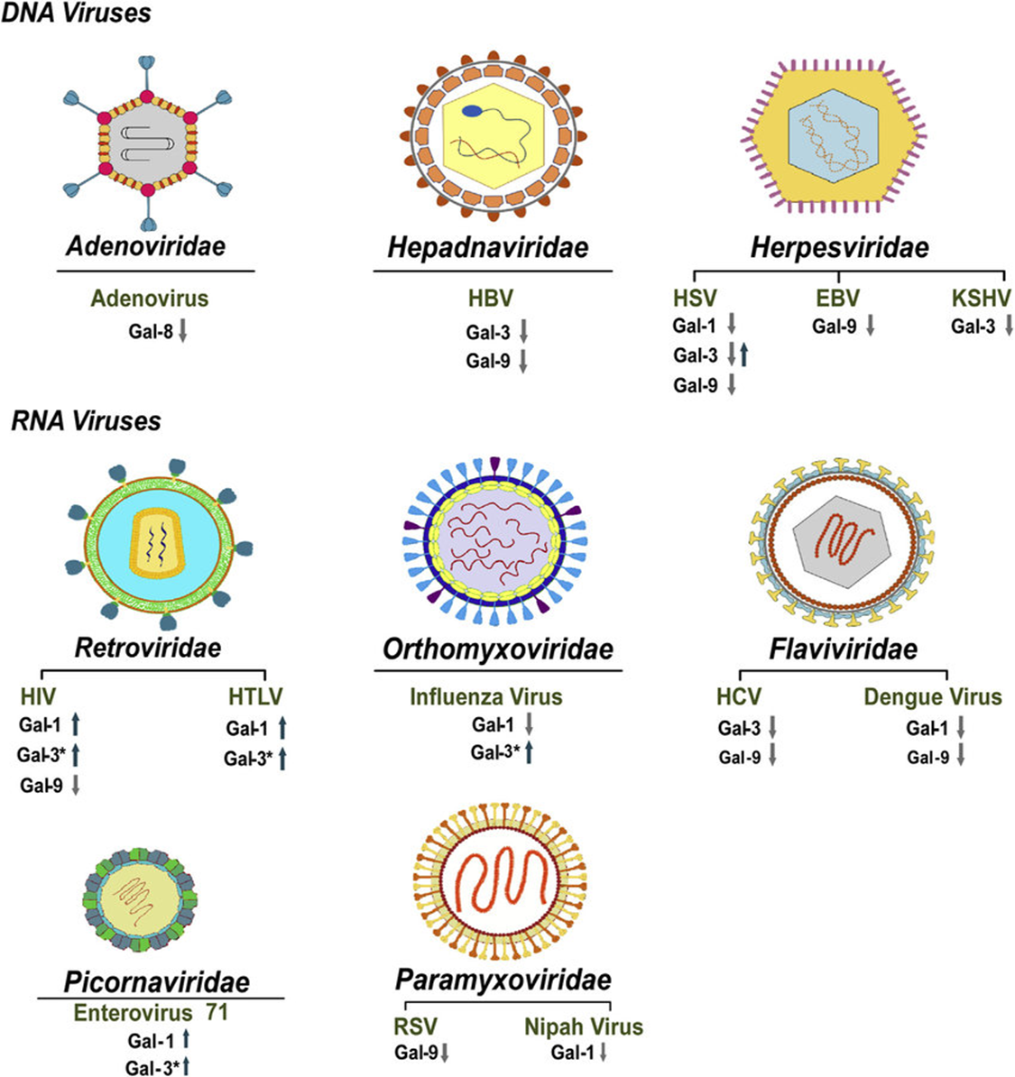

Slide 20
