Slide 1
Periapical pathology

Slide 2
3- Endodontic treatment:

Slide 4
Periapical pathology:
Chronic apical periodontitis ( periapical granuloma ).
Acute periapical periodontitis.
Acute periapical abscess.
Cellulitis.
Radicular cyst.

Slide 6
Clinical features: 1-most of periapical granulomas are asymptomatic

Slide 7
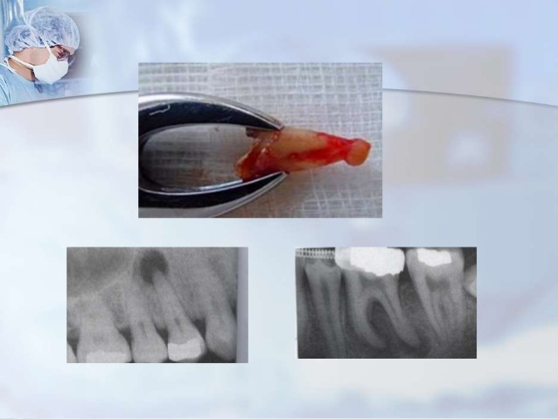

Slide 11
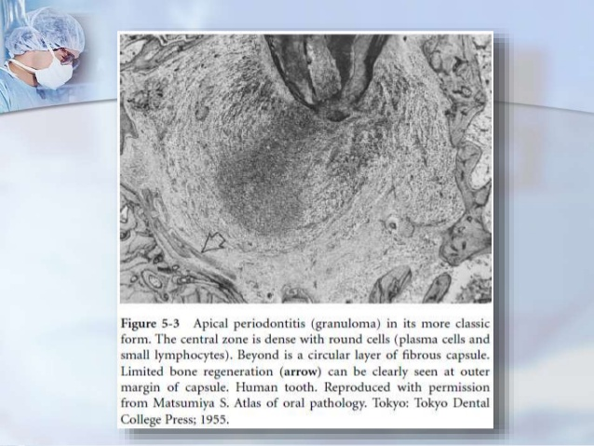

Slide 13
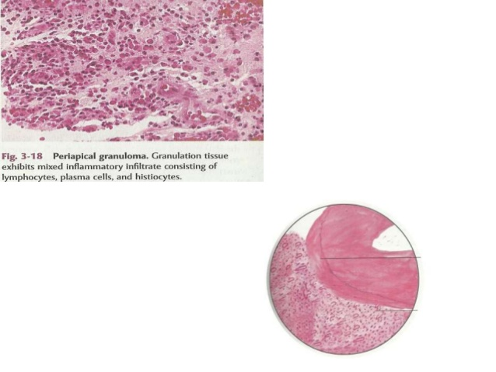

Slide 15
Acute periapical periodotitis

Slide 17
Acute periapical periodontitis:

Slide 21
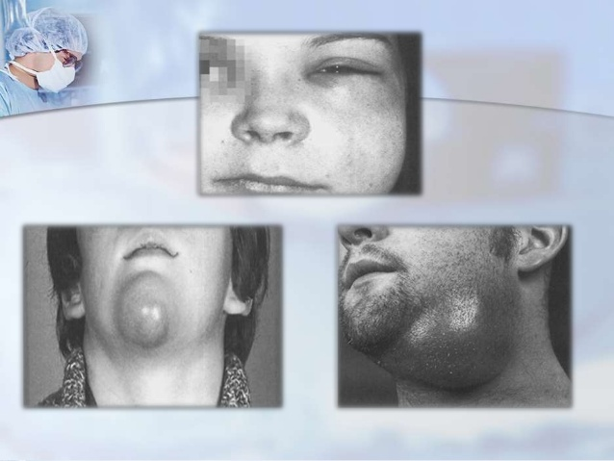

Slide 23
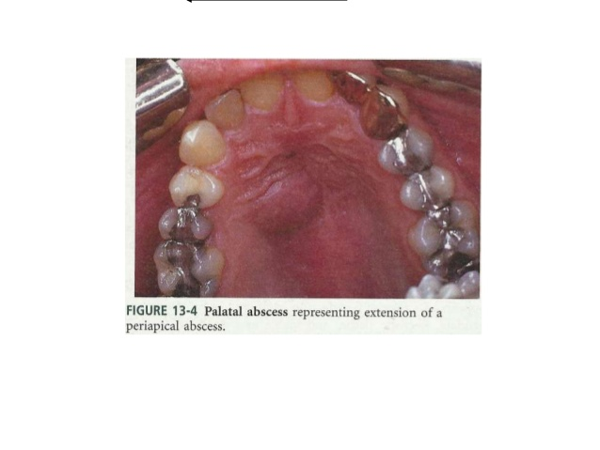

Slide 28
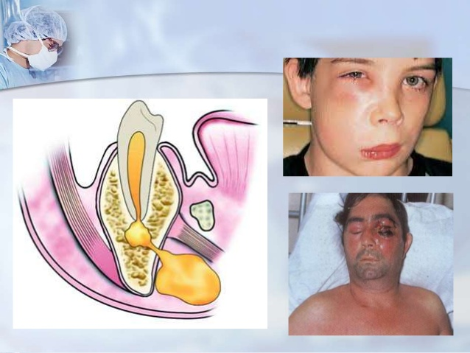

Slide 33
3- water and electrolytes
4- cholesterol crystals

