Slide 6
Ameloblastoma

Slide 16
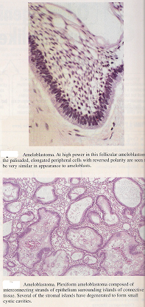
Reversed polarity of the peripheral cells

