Slide 1
Infections through skin and mucous membrane
By
Dhabyia ihsan
Abd elwahab alshekhly
2020-2021

Slide 2
Skin infections are more frequent in immunodeficient patients, seniors and infants than in healthy individuals with an intact immune system. The severity of infections ranges from localized, self-limiting cutaneous infections to widespread necrosis of the skin, muscle, and fascia. The most frequent infections of the skin and mucous membranes are caused by bacterial and viral infectious agents. Fungal infection are also important especially in immunocompromised patients. In particular, viruses play an important and increasing role in the development of several tumors including HPV-associated cervical, anal and penile cancer
The skin and mucous membranes act as a physical barrier preventing penetration by microbes. If the skin is cut then the blood produces a clot which seals the wound and prevents microbes from entering. Mucous membranes line many tracts and structures of the body, including the mouth, nose, eyelids, trachea and lungs, stomach and intestines, and the ureters, urethra, and urinary bladder. ...

Slide 3
It affects the mucous membranes, which are the thin skin coverings on the inside surface of the mouth. The membranes produce the protective mucus, as well as lining the digestive system, from the mouth to the anus. Stomatitis is a type of microsites, a condition defined as pain or inflammation of the mucous membrane.
Stomatitis is inflammation of the mouth. It affects the mucous membranes, which are the thin skin coverings on the inside surface of the mouth. The membranes produce the protective mucus, as well as lining the digestive system, from the mouth to the anus.

Slide 4
Stomatitis
Can be broken down into different categories, depending on which area of the mouth is affected:
Cheilitis – inflammation of the lips and around the mouth
Glossitis – inflammation of the tongue
Gingivitis – inflammation of the gums
Pharyngitis – inflammation of the back of the mouth
Stomatitis can be caused by a variety of different factors, which may overlap with each other at the same time. Often it will be due to injury, infection, allergy, or skin disease.
The most common causes are:
Trauma from ill-fitting dentures or braces, biting the inside of the cheek, tongue, or lip, and surgery
Chemotherapy treatment for cancer
Viral infection, such as herpes yeast infection, such as thrush any condition associated with dry mouth smoking or chewing tobacco
Other examples include: Bacterial infections-Sexually transmitted infections-Weakened or deficient immune system
Irritation from strong chemicals-Stress-Certain diseases, including Behcet’s disease, Crohn’s disease, and lupus
Medications, including sulfa drugs, anti-epileptics, and some antibiotics
Nutritional deficiencies-Allergic reactions-Burns caused by hot food and drink

Slide 5
Symptoms
Stomatitis often results in pain, stinging, and soreness. Each person may experience different symptoms. These can include:
Mouth ulcers with a white or yellow layer and red base, usually inside the lips, cheek, or on the tongue
Red patches
Blisters
Swelling
Oral dysaesthesia – a burning feeling in the mouth
Lesions that heal in 4-14 days and often recur
Diagnosis
Diagnosis will depend entirely on what is causing the stomatitis. Relevant investigations include a physical examination, as doctors can learn a lot by looking at the appearance and distribution of ulcers.
Other tests might include:
Swabs, both bacterial and viral
Tissue scrapings or swabs for fungal infections
Biopsy, or the removal of cells or tissue for further study
Blood tests Patch tests to identify allergy
A doctor will also look at a person’s medical history to see if a current or previous medication has caused the stomatitis. The doctor will also ask a person about their sexual history and whether they have ever smoked.

Slide 6
Treatment
Treatment for stomatitis will depend on the cause. Treating the root cause is important for stomatitis caused by the following:
Allergy: If caused by an allergic reaction, then the doctor will try to identify what the allergy is and look to eliminate its effects.
Infection: Stomatitis caused by an infection may require specialized treatment and medications depending on what the infection is.
Disease: If a specific disease causes stomatitis, a doctor will aim to identify this and treat it.
Nutritional deficiency: A doctor can identify and address nutritional problems with medication or diet.
Topical treatment
Topical treatments applied directly to the skin have been found to help lessen the pain and speed up healing. Types of topical treatment include:
Topical corticosteroids: Often a rinse, these aim to eliminate symptoms to allow the person to eat, drink, and speak without pain or discomfort.
Topical antibiotics: These are usually in gel or rinse format and have anti-inflammatory and antibiotic properties.
Topical anesthetics: These are numbing medications, mostly available by prescription that people can apply directly to the sores for temporary pain relief.

Slide 7
Prevention
There are basic precautions that people can take to try and stop stomatitis returning, such as:
Using an antiseptic and non-alcoholic mouthwash
Treating chronic dry mouth
Using a soft toothbrush
Maintaining proper nutrition and hydration
Receiving routine dental care

Slide 8
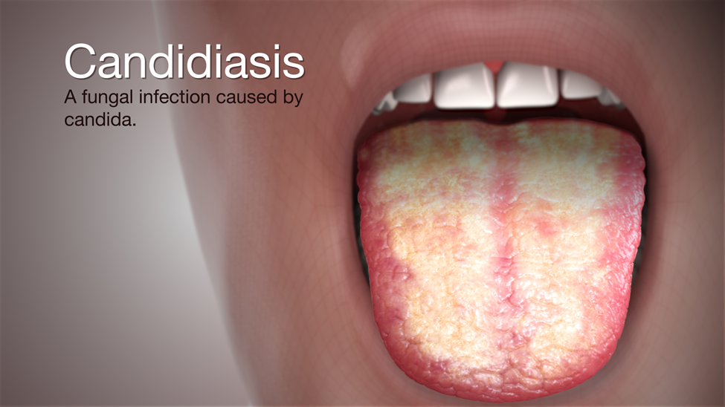

Slide 9
Candidiasis
Is an infection caused by a fungus called Candida; most commonly the Candida albicans variety. The Candida infection (also known as a yeast infection) usually affects the skin and/or the mucous membranes of the mouth, intestines, or the vagina.
Candidiasis describes a group of fungal infections involving the skin and mucous membranes. Infection is caused by Candida species, primarily Candida albicans.
Some circumstances, such as taking a long course of antibiotics or having a weakened immune system can increase your risk of developing a Candida infection. The most common Candida infections, such as vaginal and skin infections, are localized and can be treated with antifungal drugs.
However, the most common symptoms of invasive candidiasis are fever and chills that don't improve after antibiotic treatment for suspected bacterial infections. Other symptoms can develop if the infection spreads to other parts of the body, such as the heart, brain, eyes, bones, or joints.

Slide 10
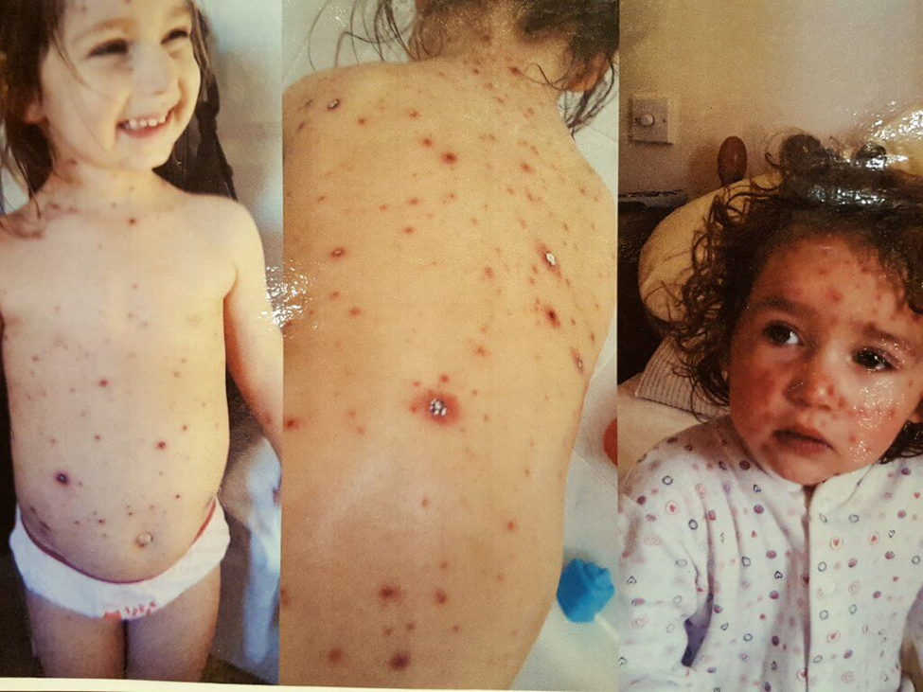

Slide 11
Chickenpox
Is caused by the varicella-zoster virus (human herpes virus type 3); chickenpox is the acute invasive phase of the infection, and herpes zoster (shingles) represents reactivation of the latent phase.
Chickenpox, which is extremely contagious, is spread by
Mucosal (usually nasopharyngeal) inoculation via infected airborne droplets or aerosolized particles
Direct contact with the virus (e.g., via skin lesions)
Chickenpox is most communicable during the prodromal and early stages of the eruption. It is communicable from 48 hours before the first skin lesions appear until the final lesions have crusted. Indirect transmission (by carriers who are immune) does not occur.
Chickenpox is rarely severe. In adults and immunocompromised children, infection can often be serious.

Slide 12
Mild headache, moderate fever, and malaise may occur 7 to 21 days after exposure, about 24 to 36 hours before lesions appear. This prodromal is more likely in patients > 10 years and is usually more severe in adults.
Lesions evolve from macules to papules and vesicles, which then crust. A hallmark of chickenpox is that lesions develop in crops so that they are in various stages of development in any affected region. The eruption may be generalized (in severe cases) involving the trunk, extremities, and face, or more limited but almost always involves the upper trunk.
Ulcerated lesions may develop on the mucous membranes, including the oropharynx and upper respiratory tract, palpebral conjunctiva, and rectal and vaginal mucosa.
In the mouth, vesicles rupture immediately, are indistinguishable from those of herpetic gingivostomatitis, and often cause pain during swallowing.
Scalp lesions may result in tender, enlarged sub occipital and posterior cervical lymph nodes.
New lesions usually cease to appear by the 5th day, and the majority are crusted by the 6th day; most crusts disappear < 20 days after onset.

Slide 13
Complications
Secondary bacterial infection (typically streptococcal or staphylococcal) of the vesicles may occur, causing cellulitis or rarely necrotizing fasciitis or streptococcal toxic shock.
Pneumonia may complicate severe chickenpox in adults, neonates, and immunocompromised patients of all ages but usually not in immunocompetent young children.
Myocarditis, hepatitis, and hemorrhagic complications may also occur.
Acute post infectious cerebellar ataxia is one of the most common neurologic complications; it occurs in 1/4000 cases in children.
Transverse myelitis may also occur.
Reye syndrome, a rare but severe childhood complication, may begin 3 to 8 days after onset of the rash primarily following the use of aspirin.
In adults, encephalitis, which can be life threatening, occurs in 1 to 2/1000 cases of chickenpox.

Slide 14
Treatment
Symptomatic treatment
Valacyclovir or famciclovir for patient’s ≥ 12 years
IV acyclovir for immunocompromised patients and others at risk of severe disease
Mild cases of chickenpox in children require only symptomatic treatment. Relief of itching and prevention of scratching, which predisposes to secondary bacterial infection, may be difficult. Wet compresses or, for severe itching, systemic antihistamines and colloidal oatmeal baths may help.
To prevent secondary bacterial infection, patients should bathe regularly and keep their underclothing and hands clean and their nails clipped. Antiseptics should not be applied unless lesions become infected; bacterial superinfection is treated with antibiotics.
Patients should not return to school or work until the final lesions have crusted.

Slide 15
Prevention
Infection provides lifelong protection.
Potentially susceptible people should take strict precautions to avoid people capable of transmitting the infection.
Vaccination
A live-attenuated varicella vaccine is available
Combination measles-mumps-rubella-varicella (MMRV) vaccine

Slide 17
Herpes simplex
infection of either the skin or the genitalia caused by either of two strains of herpes simplex virus. Herpes simplex virus type 1 (HSV-1) is transmitted orally and is responsible for cold sores and fever blisters, typically occurring around the mouth, whereas herpes simplex virus type 2 (HSV-2) is transmitted sexually and is the main cause of the condition known as genital herpes.
Anyone can be infected with HSV, regardless of age. Your risk is based almost entirely on exposure to the infection.
In cases of sexually transmitted HSV, people are more at risk when they have sex not protected by condoms or other barrier methods.
Other risk factors for HSV-2 include:
Having multiple sex partners
Having sex at a younger age
Being female
Having another sexually transmitted infection (STI)
Having a weakened immune system
If a pregnant woman is having an outbreak of genital herpes at the time of childbirth, it can expose the baby to both types of HSV, and may put them at risk for serious complications.

Slide 18
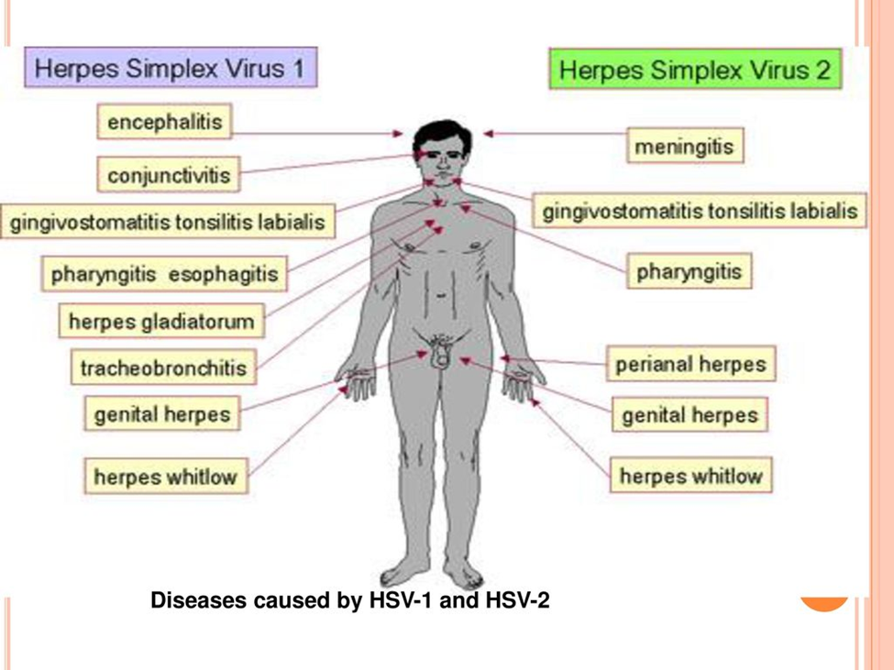

Slide 19
Some of the symptoms associated with this virus include:
Blistering sores (in the mouth or on the genitals)
Pain during urination (genital herpes)
Itching
You may also experience symptoms that are similar to the flu. These symptoms can include:
Fever
Swollen lymph nodes
Headaches
Tiredness
Lack of appetite
HSV can also spread to the eyes, causing a condition called herpes keratitis. This can cause symptoms such as eye pain, discharge, and a gritty feeling in the eye.

Slide 20
How is herpes simplex diagnosed?
This type of virus is generally diagnosed with a physical exam. Your doctor may check your body for sores and ask you about some of your symptoms.
Your doctor may also request HSV testing. This is known as a herpes culture. It will confirm the diagnosis if you have sores on your genitals. During this test, your doctor will take a swab sample of fluid from the sore and then send it to a laboratory for testing.
Blood tests for antibodies to HSV-1 and HSV-2 can also help diagnose these infections. This is especially helpful when there are no sores present.

Slide 21
How is herpes simplex treated?
There is currently no cure for this virus. Treatment focuses on getting rid of sores and limiting outbreaks.
It’s possible that your sores will go away without treatment. However, your doctor may determine you need one or more of the following medications:
Acyclovir
Famciclovir
Val acyclovir
These medications can help people infected with the virus reduce the risk of transmitting it to others. The medications also help to lower the intensity and frequency of outbreaks.

Slide 22
Preventing the spread of herpes simplex infections
Although there is no cure for herpes, you can take measures to avoid contracting the virus, or to prevent transmitting HSV to another person.
Try to avoid direct physical contact with other people.
Don’t share any items that can pass the virus around, such as cups, towels, silverware, clothing, makeup, or lip balm.
Don’t participate in oral sex, kissing, or any other type of sexual activity during an outbreak.
Wash your hands thoroughly and apply medication with cotton swabs to reduce contact with sores.
People with HSV-2 should avoid any type of sexual activity with other people during an outbreak. If the person is not experiencing symptoms but has been diagnosed with the virus, a condom should be used during intercourse. But even when using a condom, the virus can still be passed to a partner from uncovered skin.
Women who are pregnant and infected may have to take medication to prevent the virus from infecting their unborn babies.

Slide 23
Thank you
By
Dr Dhabyia Ihsan
2020-2021

