Slide 1
Dilution method
LAB 5

Slide 2
It is a quantitative method ,depend on preparation of series of gradually duplicate concentration of antibiotic in a suitable medium for growth , then adding limited number of bacteria and checking the ability of antibiotic to inhibit or kill the bacteria under testing by presence of turbidity in test tubes or not .
The diffusion test of antibiotic by using disc method is useless and do not give clear information about the bacterial sensitivity , as following :-

Slide 3
1- In case of using slow growth rate microorganism such as Mycobacterium tuberculosis (has 48 hr .generation time ) ,using disc method give wrong results because the antibiotic diffusion in agar faster than bacterial growth , for that the inhibition zone appears bigger than normal case (not truth)
2- In case of swarming bacteria such as Proteus ,the swarming movement is considered as a hinder for antibiotic diffusion and lead to make inhibition zone smaller than the normal case .

Slide 4
3- In case of using antibiotics with high molecular weight such as Bacitracin and Polymyxin B which diffuses in agar slowly ,for that the inhibition will be small or will not appear because the growth of bacteria is faster than diffusion of antibiotic.
In all above cases ,the dilution method is recommended and the MIC ( minimal inhibitory concentration ) and MBC ( minimal bactericidal concentration ) can be estimated .
MIC = the minimum concentration leads to inhibition of bacteria under testing ;

Slide 5
MBC= the minimum concentration that kill the bacteria under testing
Method :- (Tube method and well method)
1- Culture 10-10 cell/ ml bacteria under testing in sterile test tubes containing Mueller Hinton Broth or other suitable medium with different requested concentration of antibiotic
2- Add antibiotic to tubes except tube No.1 which containing (0) con. Of antibiotic as control ;tube No.2 containing lowest con. Of antibiotic ; tube No.3 containing double con. Of tube No ,2 and so.

Slide 6
3- Incubated all tube at optimum condition ,then check ; any turbidity refer to growth of bacteria while no-turbidity (clear )refer to inhibition of bacteria by antibiotic action.
To determine MIC : select the 1st clear tube (no bacterial growth) ranked at serial turbidity tubes ,this tube contains MIC of antibiotics .
To determine MBC : take 0.1 ml from clear tubes and transfer to pet dishes containing Mueller Hinton agar and spread on the surface of agar then incubate at 37C for 24 -48hr . And then check the growth of colonies in each plate

Slide 7
The 1st plate that dose not show any colony represents the concentration of antibiotic for clear tube and is considered MBC for example the following flow chart .
Questions
Container contains 500 mg of tetracycline ,prepare the following concentration 10 mg/ml ,500 mg/ml and 50 mg/ml with final volume 10 ml to tested againt E.coli

Slide 8
Epsilometer test (E test ) : diagnostic device used by laboratories to determine the MIC and whether or not a specific strain of bacterium or fungus is susceptible to the action of a specific antimicrobial . This type of test is most commonly used in healthcare settings to help guiding physicians in treatment of patients by indicating what con .of antimicrobial would successfully treats an infection .
The E test consist of a thin reagent plastic strip that carries a continuous con. Gradient of stabilized and dried antibiotic with strongest being at the top of strip and the weakest at the bottom and providing quantitative wide-range

Slide 9
MIC in a simple and easily reproducible manner (E test is easy to exam) the gradient range is equivalent to 15 dilutions by a conventional reference MIC procedure.
E test is a quantitative technique for determining the antimicrobial susceptibility (MIC) in mg/ml of G+ve and G- ve bacteria aerobic bacteria such as Enterobacteriaceae , Pseudomonas ,Staphylococcus and Enterococcus species and fastidious bac. Such as anaerobes N. gonorrhoeae ,S.pneumoniae ,Streptococcus and Haemophilis species

Slide 10
Methods :
1- The surface of agar plate inoculated with an adjusted bacterial suspension by swab in the same manner as a disk diffusion test .
2- One or more E test strips for the antimicrobial agents to be tested are then placed on the inoculated agar surface .
3- After an overnight incubation ,the interaction of the antimicrobial agent gradient and the test bacterial inoculum gives rise to elliptical inhibitory zones
4-The results are read in the intersection of the ellipse with a MIC scale

Slide 11
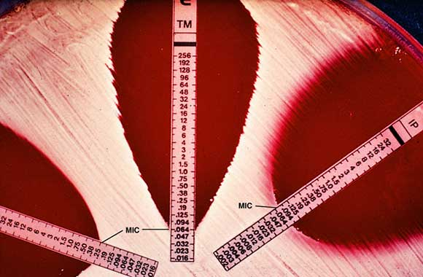

Slide 12
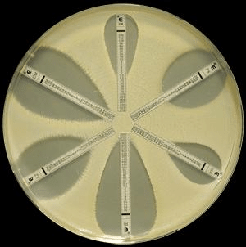

Slide 13
E –test can help to :-
Determine the MIC of fastidious ,slow –growing or nutritionally deficient microorganism that have unique growth requirement and cannot be testing by automated methods ,r for a specific type of patient or infection
Detect low levels of resistance
Test antimicrobial not performed in routine use or a new recently introduced antimicrobial agent
Confirm an equivocal antibiotics sensitivity test results .

