Slide 1
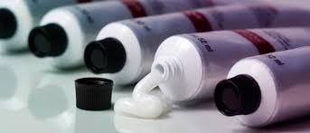
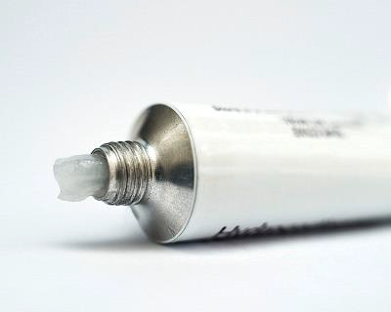
Semisolid Dosage Forms

Slide 2
Skin structure and function Human skin is a highly complex multi-layered structure and it represents the largest organ of the body, comprising around 10% of the body mass. The main function of the skin is to act as a barrier between the body and the outside environment. This barrier prevents the entry of chemicals, microorganisms , UV radiation and the loss of water and body fluids. In addition, the skin plays role in the regulation of body temperature and it also acts as sensory organ.

Slide 3
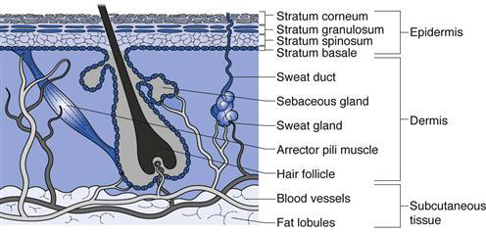
Skin layers 1.The Epidermis 2.The Dermis 3.The Subcutaneous Fatty layer

Slide 4
Ointments, creams, pastes and gels Ointments, creams, pastes and gels are semisolid dosage forms intended for topical application They may be applied to the skin, placed on to the surface of the eye or used nasally, vaginally or rectally. The majority of these preparations are used for the effects of the therapeutic agents they contain. Those which are non medicated are used for their physical effects lubricants.

Slide 5
Topical preparations are used for the localized effects produced at the site of their application, although some unintended systemic drug absorption may occur, Transdermal drug delivery systems are designed for the systemic absorption of drug substances in therapeutic quantities.

Slide 6
Creams Pharmaceutical creams are semisolid preparations containing one or more medicinal agents dissolved in either an o/w or w/o emulsion. Creams have a relatively soft, spreadable consistency. An example of an o/w cream is vanishing cream and an example of a w/o cream is cold cream. When the term “cream” is used without further qualification, awater-washable formulation is generally inferred.

Slide 7
Creams find primary application in topical skin products and also in products used rectally and vaginally. Many patients and physicians prefer creams to ointments because they are easier to spread and remove than ointments. Pharmaceutical manufacturers frequently manufacture topical preparations of a drug in both ointment and cream bases to satisfy the preference of the patient and physician.

Slide 8
Preparation of creams Creams may be formulated from variety of oils ( both mineral and vegetable)and from fatty alcohols, fatty acids and fatty esters. Emulsifying agents include non-ionic surfactants and soaps. Preparation involves separating the formula components into two portions :lipid and aqueous. The lipid portion contain water-insoluble components and the aqueous portion the water-soluble components. .

Slide 9
Vanishing creams are o/w emulsions containing large percentage of water and stearic acid. After application of the cream, the water evaporates leaving behind a thin residue film of stearic acid or other oleaginous components.
Both phases are heated to a temperature above the melting point of the highest melting component. The phases then are mixed, and the mixture is stirred until reaching ambient temperature or the mixture has congealed. Mixing is continued during the cooling process to promote uniformity

Slide 10
Gels Gels are usually clear , transparent non-greasy semisolids containing solubilized active substances in an aqueous liquid vehicle rendered jelly-like by the addition of a gelling agent. Among the gelling agent used are synthetic macromolecules such as carbomer, cellulose derivatives as carboxy methylcellulose or hydroxy propyl cellulose and natural gums as tragacanth

Slide 11
Gels may be used as lubricants or medicated gels administered by various routes including the skin, the eye , the nose , the vagina and the rectum. In addition to the gelling agent and water, gels may be formulated to contain a drug substance , solvents such as alcohol and/ or propylene glycol , antimicrobial preservatives such as methyl and propyl parabens and stabilisers such as edetatedisodium.

Slide 12
Rx vanishing cream stearic acid 200g potassium hydroxide 14g purified water 800g Ft. cream sig. apply b.i.d Rx cold cream spermaceti 125g white wax 120g liquid paraffin 560g sodium borate 5g purified water 190g Ft. cream

Slide 13
Rx zinc gelatin (glycero gelatin jelly) zinc oxide 15g gelatin 15g glycerol 35g purified water 35g Ft. gel sig. for external use

Slide 14
Rx bentonite gel zinc oxide 10g glycerol 10g bentonite 10g purified water 100g Ft. Gel

