Slide 1
General urine examination
Lab 2

Slide 2
Physical examination
1- Color
Transparent: sign of over hydration .A person has been drinking a little too much water.
Pale Yellow: mean a person is healthy and hydrated.
Transparent Yellow: Normal.
Dark Yellow : Normal but needs to drink more water .

Slide 3
4- Brownish orange : sign of dehydration or a possible sign of liver disease .
5- Pinkish red possibly a sign of kidney disease .UTI or tumor .
6-Blue or Green : sign of a rare genetic disease.
7- Foamy : sign of kidney disease .

Slide 4
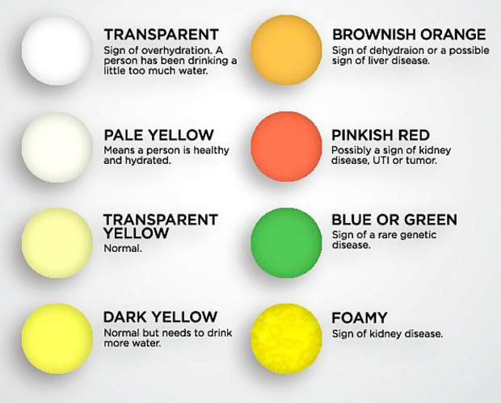

Slide 5
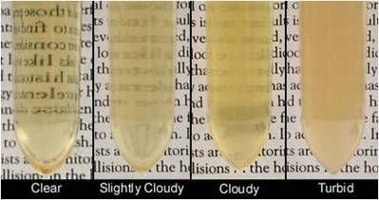
2-Odor
May be altered by presence of acetone producing fruity odor (diabetes)
Or by bacterial decomposition producing ammonicidal odor
3- Transparency and Turbidity

Slide 6
4- Volume
Normal range | Condition increased | Condition decreased
1000-1800ml /day | Diuretic therapy | Excess sweating
 | Diabetes insipidus | Dehydration
 | Diabetes mellitus | Acute renal failure
Polyuria: Urine output =>2.5 litres /day
Oliguria :Urine out out = 300 to 500 ml /day
Anuria: Urine output = <50 ml / day

Slide 7
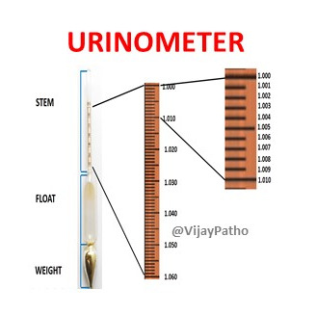
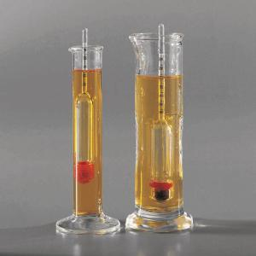
5- specific gravity
Refractometer
Reagent strip
Urinometer

Slide 8
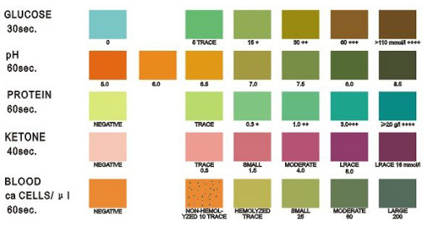
Chemical examination
1- PH
Normal: 5-7
Acidic: 4.5-5 (Diabetes , precipitation of uric acid and oxalate crystals)
Basic : 7.8-8 (UTI ,plant nutrition ,precipitation of phosphate crystals)

Slide 9
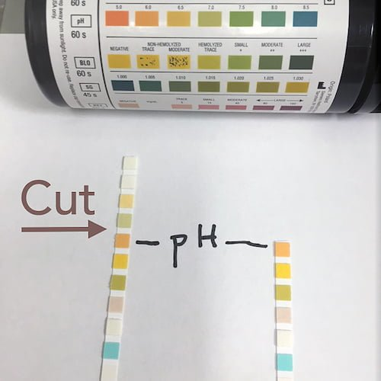
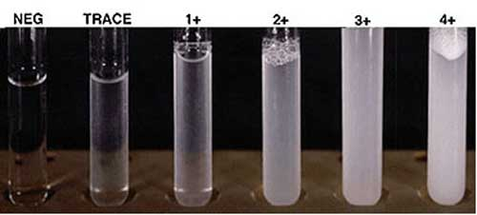
2- Protein
By sinking strip (change in color )
Or by adding 3 drop of sulphosalicylic acid to 5 ml of urine (precipitate)

Slide 10
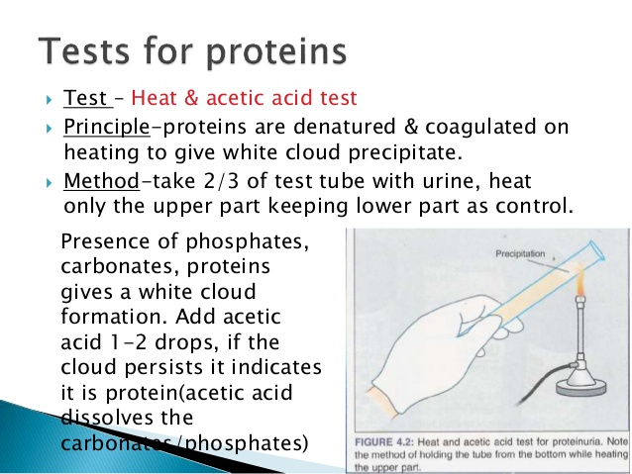
Heat and acetic acid

Slide 11
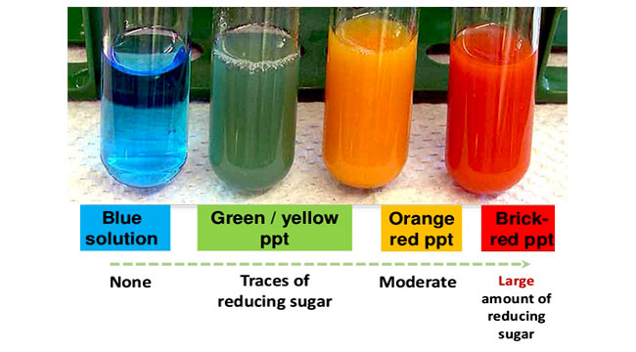
3- sugar (glucose)
Sinking strip --- change color
Or by adding 5 ml regent (cupric sulphate (blue) +8 drop urine – heating --- color trace
Sugar gave positive result in urine when its level in blood above 180

Slide 12
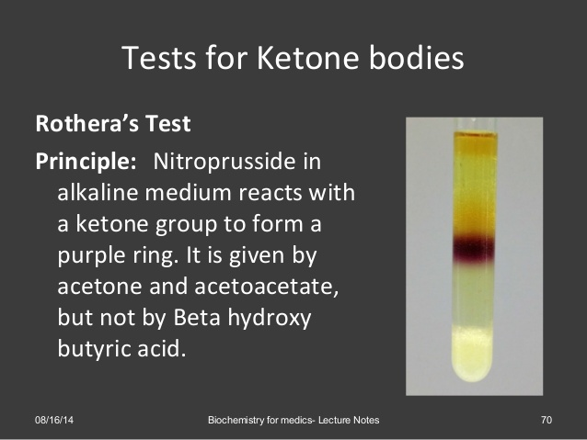
4- Keton bodies
Detect by strip
Rotheras test Appear in sever diabetes ,dehydration ,bad nutrition, vomiting

Slide 13
5- Bile salts
Normal urine didn’t contain bile salts but it found when there is infection in gall bladder .Detect by same strip or adding sulfer powder –float (negative) precipitate(positive)
6- Bilirubin and urobilinogen
Detect by the same strip

Slide 14
