Slide 1
3rd year 1st semester 2021 Biochemistry Lab 9 Acrolein Test copper acetate Test
AL-RASHEED PHARMACY Dpt.

Slide 2
Acrolein test
Most lipids are found in the form of triglycerides, an ester formed from glycerol and fatty acids. When a fat is heated strongly in the presence of a dehydrating agent such as KHSO4, the glycerol portion of the molecule is dehydrated to form the unsaturated aldehyde, acrolein

Slide 3
Aim of test
1- To detect the presence any type of fat or oil in given sample.
2-To distinguish between any oily substances from fat or oil.

Slide 4
Principle
When a fat is heated strongly in the presence of a dehydrating agent such as KHSO4, the glycerol portion of the molecule is dehydrated to form the unsaturated aldehyde, acrolein CH2=CH-CHO, which can be distinguished by its irritating smell as burnt grease.

Slide 5
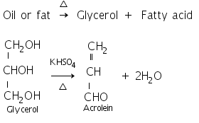
Reaction

Slide 6
Procedure
Take the sample to be tested in a test tube.
Add few crystals of potassium bisulfate to it.
Heat the mixture and observe the change in odor.
If there is pungent irritating odor then the presence of fat or oil is confirmed.

Slide 7
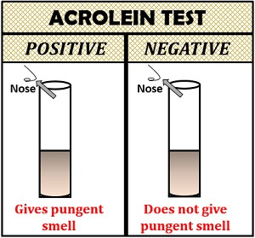
Results

Slide 8
Copper acetate test

Slide 9
Aim of test
This test is used to distinguish between oil [neutral fat] and fatty acid [saturated and unsaturated].

Slide 10
Principle
The copper acetate solution does not react with the oils (or fats), while fatty acids [saturated and unsaturated ] react with copper acetate to form copper salt.
→ Copper salt formed in the case of fatty acids can only be extracted by petroleum ether.

Slide 11
Procedure
Take two test tubes add 3 ml of petroleum ether and an equal volume of a solution of copper acetate.
Add 0.5 ml of Oleic acid and Olive oil in each tube
Shake the tube and leave it for some time.

Slide 12
Results
olive oil: notice that petroleum ether upper layer containing the dissolved oil and appears colorless. aqueous solution remains blue in the bottom.
Oleic acid: The upper layer of petroleum ether becomes green as a result of copper oleate [copper salt]. The lower layer becomes less in blue.

Slide 13
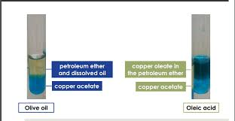
Results

Slide 14
End
THANK YOU FOR LISTINING
Prepared by:
Assis.Lect.Nabigh Al-SHARIFI

