Slide 1
DATA ACQUISITION SYSTEM
كلية الرشيد الجامعة قسم هندسة تقنيات الحاسوب
Instruments and Measurements
Lecture(7)
by :
Msc. Ayia A.Salam

Slide 2
Topics To Discuss
Introduction to DAS
Objectives of a DAS
Block diagram and explanation
Methodology

Slide 3
INTRODUCTION

Slide 4
INTRODUCTION
DATA ACQUISITION is the process of sampling signals that measure real word physical conditions and converting the resulting samples into digital numeric values that can be manipulated by a computer.
Data acquisition systems (DAS or DAQ) typically convert analog waveforms into digital values for easy processing.

Slide 5
INTRODUCTION
The components of data acquisition systems include:
Sensors that convert physical parameters to electrical signals.
Signal conditioning circuitry to convert sensor signals into a form that can be converted to digital values.
Analog-to-digital converters, which convert conditioned sensor signal to digital values.

Slide 6
OBJECTIVE
DAS must acquire the necessary data, at correct speed and at correct time.
It must monitor the complete plant operation to maintain on line and safe operation
It must be able to collect, summaries and store data for diagnosis of operation and record purpose.
It must be flexible and capable of being expanded for future requirements
It must be reliable, easy to operate and must be user friendly.

Slide 7
BLOCK DIAGRAM

Slide 8
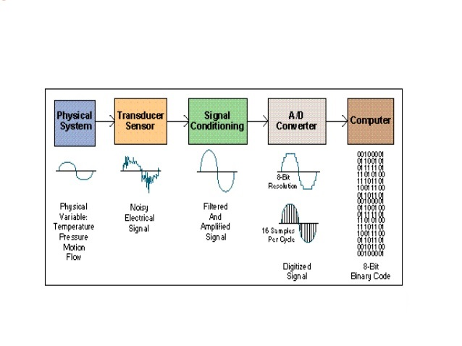
DAS Block Diagram

Slide 9
Physical System
Physical system that can be used as input of DAS or which can be represented in Digital form are as under...
Temperature
Pressure
Light
Force
ON/OFF switch

Slide 10
Transducers
A transducer converts temperature, pressure, length, position, etc. into voltage, current, frequency, or other signals.
A transducer thus converts the physical conditions in electrical waveform for easy signal processing.

Slide 11
Signal Conditioning
Signal conditioning circuits improve the quality of signals generated by transducers before they are converted into digital signals.
Most common signal conditioning functions are amplification, linearization, filtering, attenuation, and so on.

Slide 12
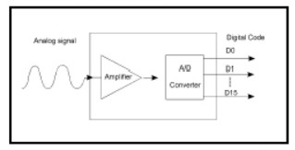
Analog Digital(A/D) converter
Analog to digital (A/D) conversion changes analog voltage or current levels into digital information. The conversion is necessary to enable the computer to process or store the signals.

Slide 13
METHODOLOGY

Slide 14
METHODOLOGY
DAS begins with the physical property to be measured. Examples of this include temperature, light intensity, gas pressure, force, etc.
A sensor, which is a type of transducer converts a physical property into electrical signal.
Signal conditioning may be necessary if the signal from the transducer is not suitable for the DAS.
After signal conditioning the analog wave output is converted into digital form using A/D converter.
This whole process is called as DATA ACQUISITION SYSTEM.

