Slide 1
System of Linear Equations (Part 2: Indirect Method)
Al-Rasheed University Collage
Computer Techniques Engineering Department
Third Class / Engineering Analysis
Lec.8
Roweda.M.Mohammed

Slide 2
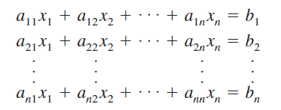
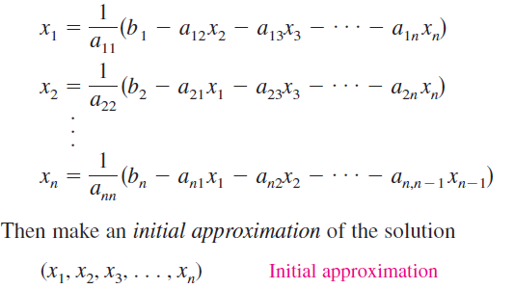
Jacobi Iteration Method:
This method makes two assumptions: (1) that the system
has a unique solution and (2) that the coefficient matrix A has no zeros on its main diagonal. If any of the diagonal entries are zero, then rows or columns must be interchanged to obtain a coefficient matrix that has all nonzero entries on the main diagonal.
To begin the Jacobi method, solve the first equation for the second equation for
and so on, as follows

Slide 3
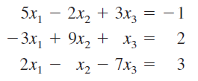
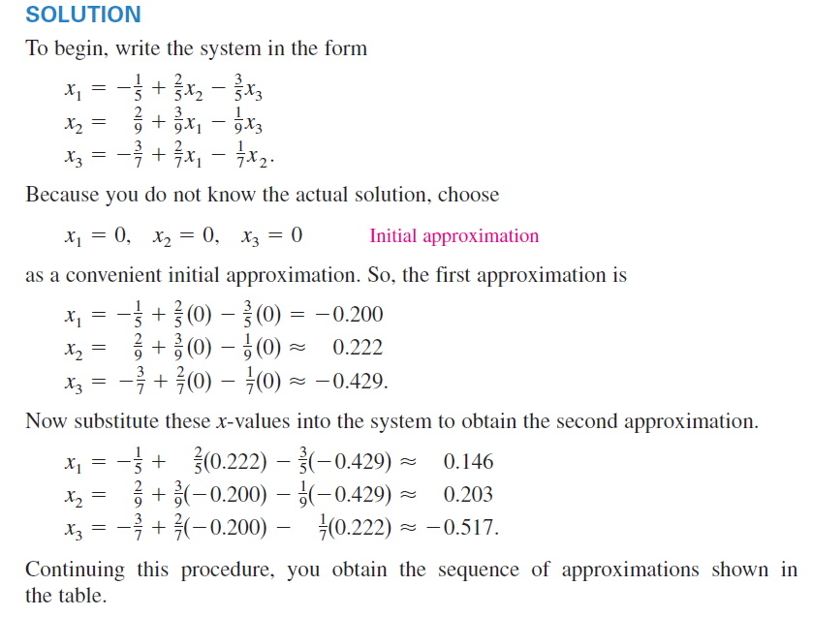
Jacobi Iteration Method:
Example: Use the Jacobi method to approximate the solution of the following system of linear equations.

Slide 4
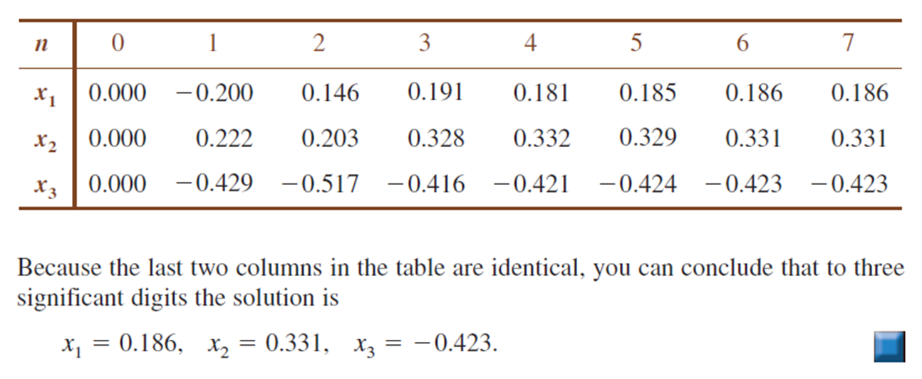

Slide 5
The Gauss-Seidel Method:
You will now look at a modification of the Jacobi method called the Gauss-Seidel method. This modification is no more difficult to use than the Jacobi method, and it often requires fewer iterations to produce the same degree of accuracy.
With the Jacobi method, the values of obtained in the nth approximation remain unchanged until the entire (n+1)th approximation has been calculated. On the other hand, with the Gauss-Seidel method you use the new values of each as soon as they are known. That is, once you have determined from the first equation, its value is then mused in the second equation to obtain the new Similarly, the new and are used in the third equation to obtain the new and so on. This procedure is demonstrated in Example below.

Slide 6
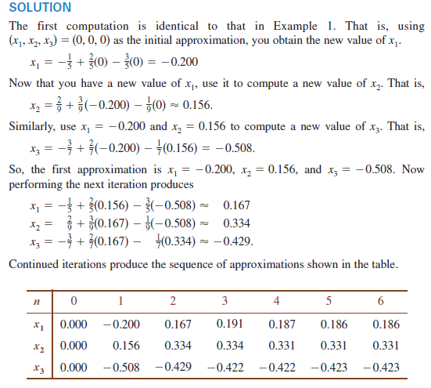
The Gauss-Seidel Method:
Example: Use the Gauss-Seidel iteration method to approximate the solution of the following system of linear equations.

Slide 7
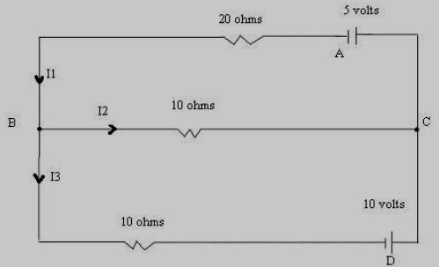
Engineering Application
Example: Determine the currents I₁, I_{2,} and I₃ for the following electrical network:
Applying Kirchhoff’s first Law to either of the nodes B or C, we find
I₁=I₂+I₃ . In other words: I₁-I₂-I₃ =0.
Applying Kirchhoff’s second Law to the loops BDCB and BCAB, we obtain the equations:
This gives a linear system of three equations:
The augmented matrix of the above system is
which can be reduced to
Therefore, the currents are:

