Slide 1
System of Linear Equations (Part 1: Direct Method)
Al-Rasheed University Collage
Computer Techniques Engineering Department
Third Class / Engineering Analysis
Lec.7
Roweda.M.Mohammed

Slide 2
System of Linear Equations
Solution using direct and indirect (iterative) methods:
A system of (n) linear equations in (n) unknowns (variable)
x₁, x₂, …. , x_{n}
is a set of equations of the form:
a₁₁ x₁ + a₁₂ x₂ + … + a_{1n} x_{n} = b₁
a₂₁ x₁ + a₂₂ x₂ + … + a_{2n} x_{n} = b₂
a_{n1} x₁ + a_{n2} x₂ + … + a_{nn} x_{n} = b_{n}

Slide 3
Two methods are used to solve such equations:
_{1. Direct Method:}
a. Gaussian Elimination Method.
2. Indirect Method (Iteration Method):
a. Gauss – Seidel (GS) Method.
b. Jacobi Iteration Method.

Slide 4
Direct Method
_{Gaussian Elimination Method:}
Number of variables (unknowns)= Number of equations:
Example: Solve the following system of equations using Gaussian Elimination Method:
Solution:

Slide 5
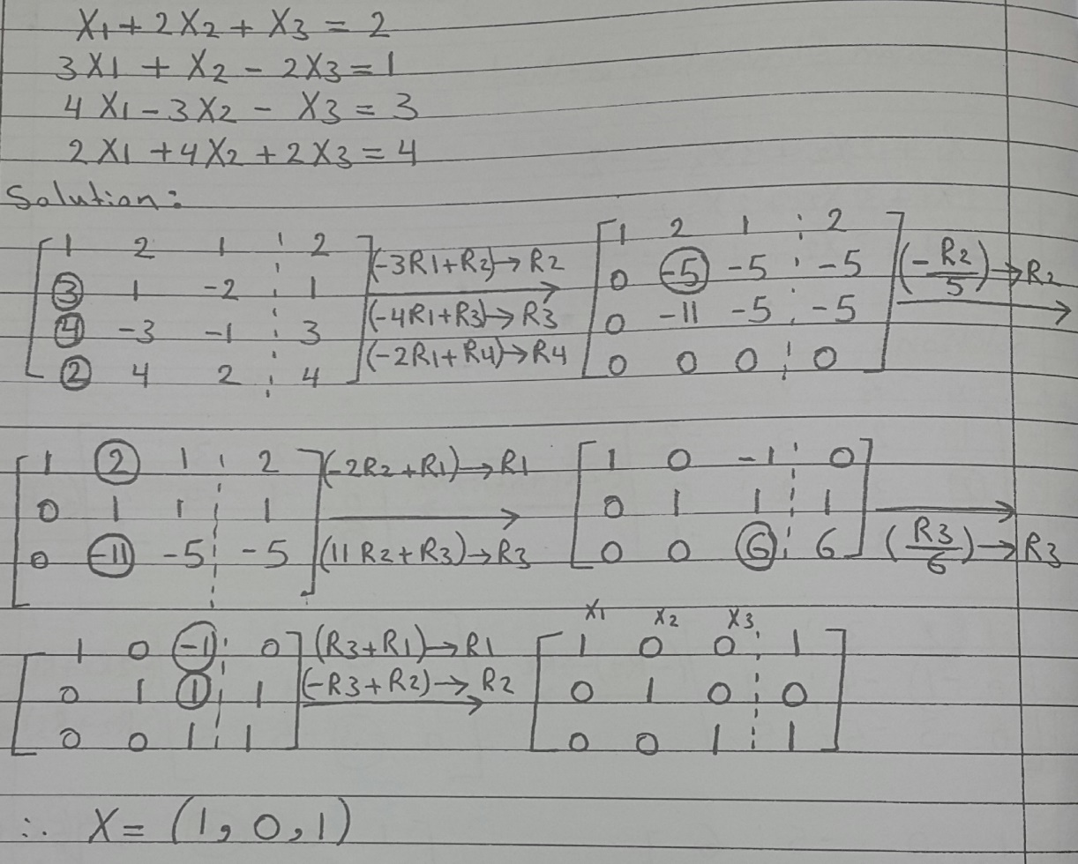
_{Gaussian Elimination Method:}
b. Number of variables (unknowns) < Number of equations:
Example: Solve the following system of equations using Gaussian Elimination Method:

Slide 6
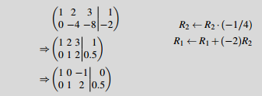
_{Gaussian Elimination Method:}
c. Number of variables (unknowns) > Number of equations:
Example: Solve the following system of equations using Gaussian Elimination Method:
Solution:

