Slide 1

Z-Transform
Al-Rasheed University Collage
Computer Techniques Engineering Department
Third Class / Engineering Analysis
Lec.5
Roweda.M.Mohammed

Slide 2
Z-Transform
The z-transform is the most general concept for the transformation of discrete-time series.
For a given sequence x[n], its z-transform X(z) is defined as:
where z = Re(z) + j Im(z) is a complex variable
that can be represented as z=r e^{jω}
imaginary
z
r
ω
real

Slide 3
Region of Convergence
The set of values of z for which the z-transform converges.
Each value of r represents a circle of radius r.
The region of convergence is made of circles.
Im
Example: z-transform converges for values of 0.5 < r < 2
  ROC is shown on the left
  In this example the ROC includes the unit circle.
Not all sequence have a z-transform
Example:
  Does not converge for any r
  No ROC, No z-transform
  Sequence has finite energy
Re

Slide 4
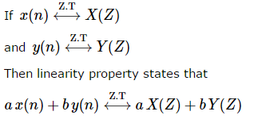
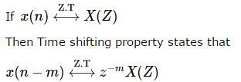
Properties of Z-Transform
Z-Transform has following properties:
Linearity Property:
Time Shifting Property:

Slide 5
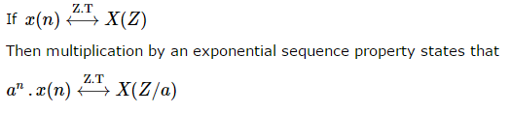
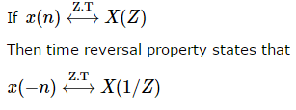
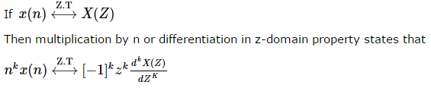
Multiplication by Exponential Sequence Property:
Time Reversal Property:
Multiplication by n Property:

Slide 6
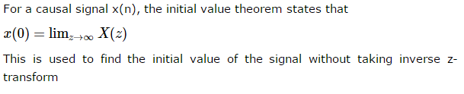
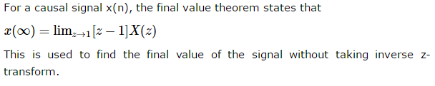
Initial Value and Final Value Theorems:
Initial value and final value theorems of z-transform are defined for causal signal.
Initial Value Theorem:
Final Value Theorem:

Slide 7
Example:
For Convergence we require
Inside the ROC series converges to
Im
a
1
o
x
Re
Region outside the circle of radius a is the ROC
Clearly, X(z) has a zero at z = 0 and a pole at z = a.

Slide 8
Example: Two-Sided Exponential Sequence
Im
x
o
o
x

Slide 9
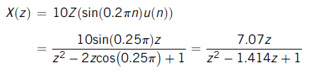
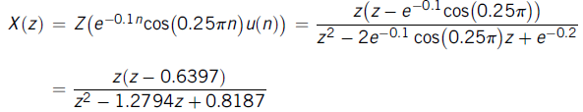
Example 3:
Find the z-transform for each of the following sequences:
a.
b.
Solution:
a.
b.

Slide 10
