Slide 1
Inverse Laplace Transform (Part 2)
Al-Rasheed University Collage
Computer Techniques Engineering Department
Third Class / Engineering Analysis
Lec.4
Roweda.M.Mohammed

Slide 2
The Convolution
Let f(t) and g(t) be two functions of t. The convolution of f(t) and g(t) is also a function of t, denoted by (f ∗ g)(t) and is defined by the relation:

Slide 3
Example: Find the convolution of f and g if f(t) = tu(t) and

Slide 4
Using Inverse Laplace Transforms to Solve Differential Equations
Laplace Transform of Derivatives:
We use the following notation:
(a) If we have the function g(t), then G(s)=G=L{g(t)}.
(b) g(0) is the value of the function g(t) at t = 0.
(c) g'(0), g’’(0),... are the values of the derivatives of the function at t = 0.
If g(t) is continuous and g'(0), g’’(0),... are finite, then we have the following.
First Derivative:
Second Derivative:
NOTATION NOTE: If instead of g(t) we have a function y of x, then Equation below would simply become:

Slide 5
For the n-th derivative:
NOTATION NOTE: If we have y and it is a function of t, then the notation would become:

Slide 6
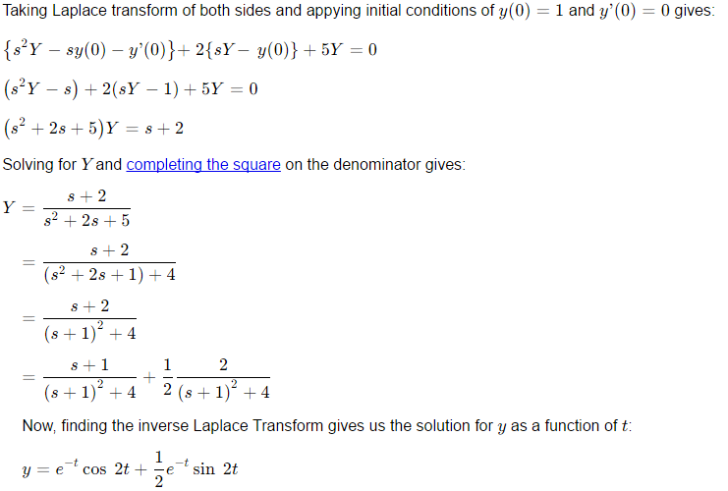
Example:

Slide 7
Applications of Laplace Transforms
Circuit Equations:
There are two (related) approaches:
Derive the circuit (differential) equations in the time domain, then transform these ODEs to the s-domain;
Transform the circuit to the s-domain, then derive the circuit equations in the s-domain (using the concept of "impedance").
We will use the first approach. We will derive the system equations(s) in the t-plane, then transform the equations to the s-plane. We will usually then transform back to the t-plane.

Slide 8
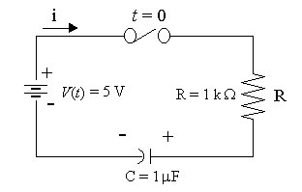
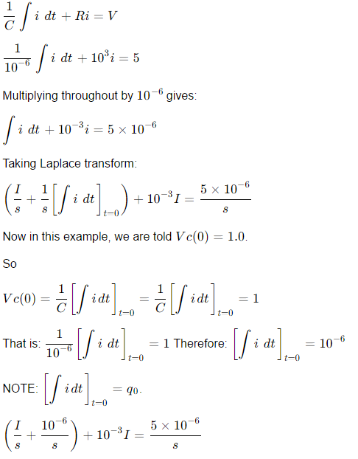
Example:

Slide 9
