Slide 1
Laplace Transform (Part 1: Functions)
Al-Rasheed University Collage
Computer Techniques Engineering Department
Third Class / Engineering Analysis
Lec.1
Roweda.M.Mohammed

Slide 2
Why Use Laplace Transforms?
Find solution to differential equation using algebra.
Relationship to Fourier Transform allows easy way to characterize systems.
No need for convolution of input and differential equation solution.
Useful with multiple processes in system.

Slide 3
How to Use Laplace
Find differential equations that describe system.
Obtain Laplace transform.
Perform algebra to solve for output or variable of interest.
Apply inverse transform to find solution.

Slide 4
Definition of the Laplace Transform
The Laplace transform ℒ, of a function f(t) for t > 0 is defined by the following integral over 0 to $∞$
t is real, s is complex, where s =σ+jω.
Inverse requires complex analysis to solve.
Note “transform”: f(t) → F(s), where t is integrated and s is variable.
Conversely F(s) → f(t), t is variable and s is integrated.
Assumes f(t) = 0 for all t < 0.

Slide 5
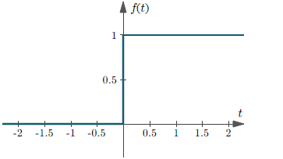
Laplace Transform of Some Important Functions
Unit step function: f(t) = u(t):
Exponential function:
Sint Function:
let
let
Integrate by parts

Slide 6
Evaluating F(s)=L{f(t)}- Hard Way
remember
let
Substituting, we get:
let
It only gets worse…

Slide 7
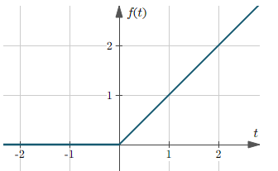
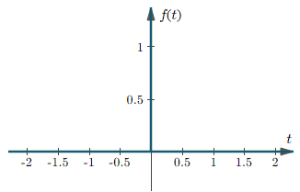
Ramp function: f(t) = (t)
Impulse function: f(t)=δ(t)

Slide 8
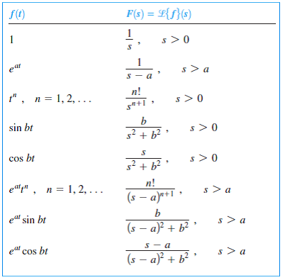
Table of Selected Laplace Transforms

