Slide 1
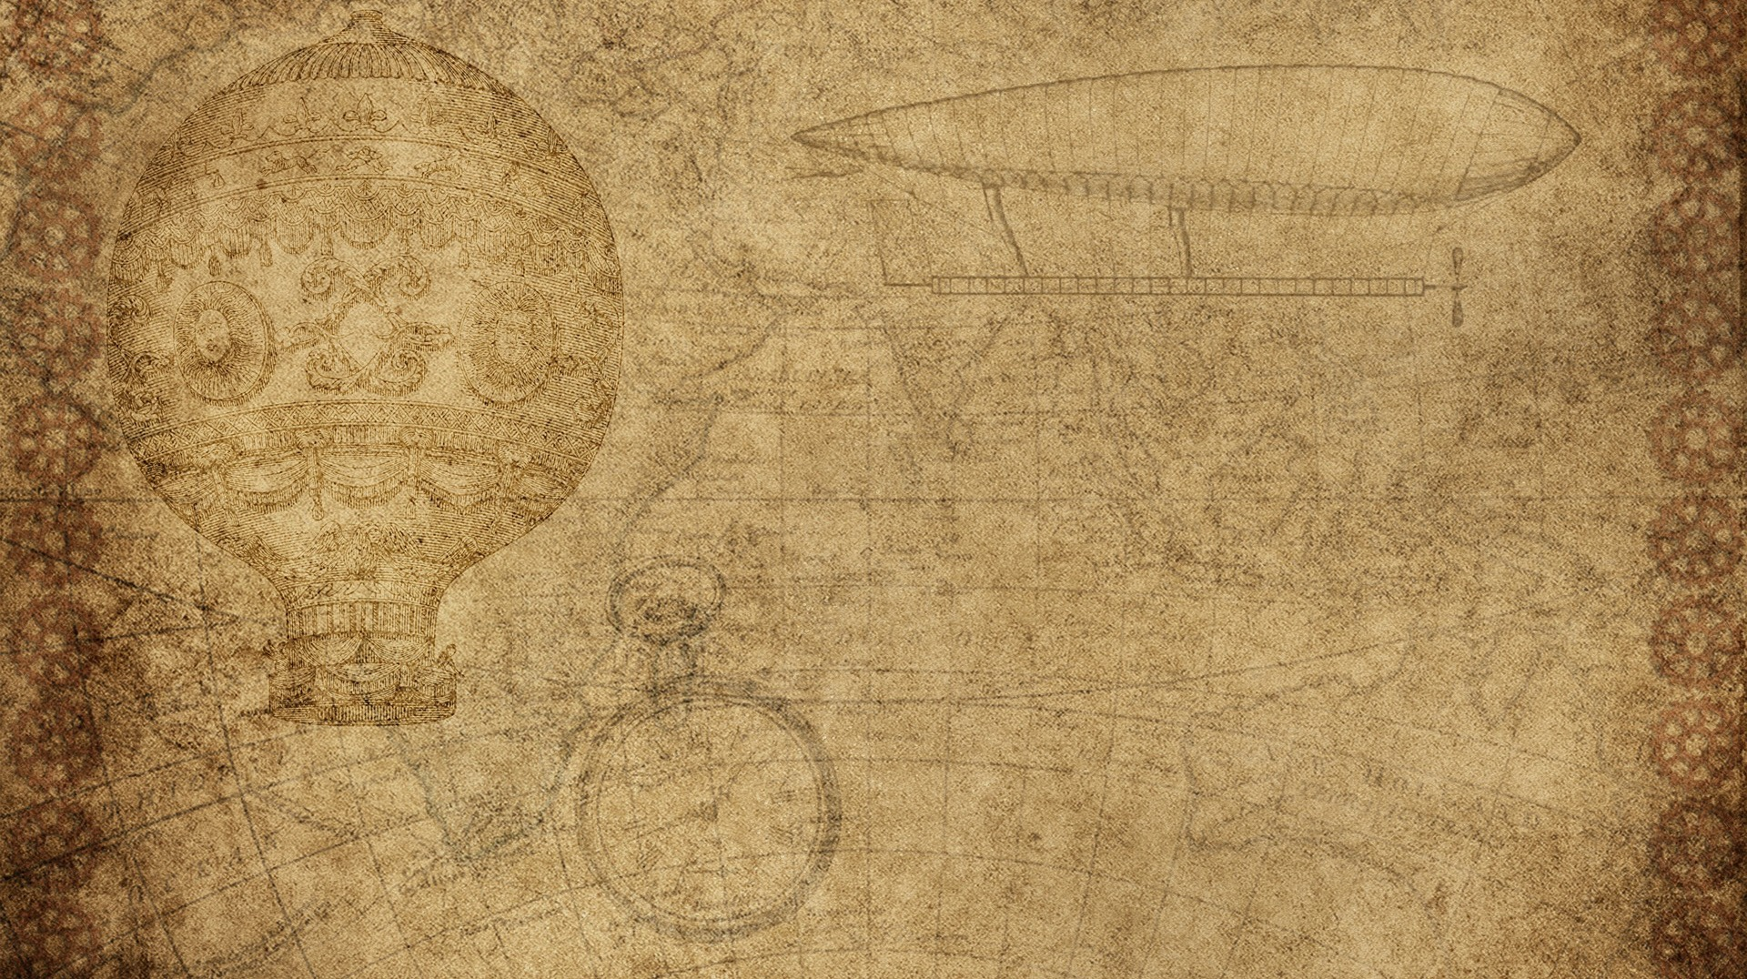

Biology 4th Stage
Comparative Anatomy lab No. 2
Edit by Dr. hind mahmood jumaah

Slide 2
1- Class : Amphibia
Have a different shape of the body.
Integument soft and glandular ( mucous and poisonous glands ).
Sexes are separated, and fertilization usually external ,but it is internal in some species.
  1- Order : Anura (The Iraqi frog)
  2- Order : Urodela (The Salamander)

Slide 3
1- Order : Anura (The Iraqi frog)
  Phylum : Chordata
  Subphylum : Vertebrata
  Superclass : Tetrapoda
  Class : Amphibia
  Order : Anura ( Salientia ).
  Family : Ranidae
  Genus : Rana
  Species :Rana ridibunda

Slide 4
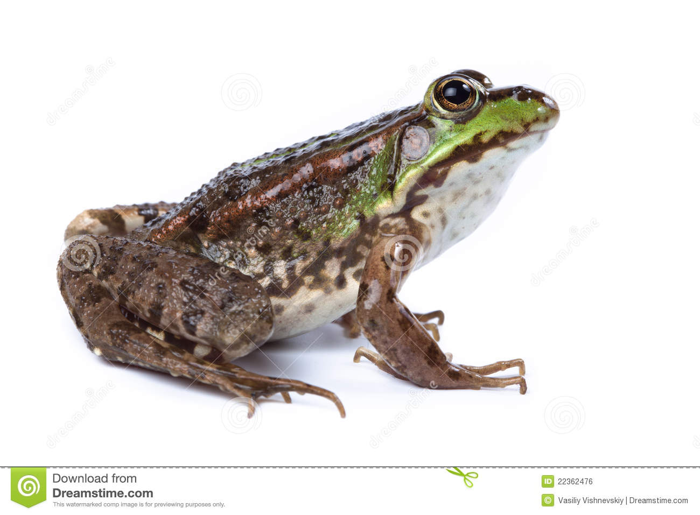
Order : Anura (The Iraqi frog)

Slide 5
2- Order : Urodela (The Salamander)
  Phylum : Chordata
  Subphylum : Vertebrata
  Superclass : Tetrapoda
  Class : Amphibia
  Order : Urodela (caudate)
  Family : Proteidae
  Genus : Necturus
  Species : Necturus maculosus

Slide 6
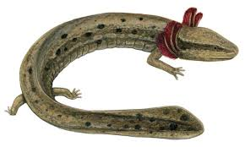
Order : Urodela (The Salamander)

Slide 7
2- Class : Reptilia
Reptiles represented the first group (class) of amniotic vertebrate, which have the amniotic eggالبيضه السلويه
The integument dry ,with almost lack the integumentary glands and covered by epidermal scalesحراشف بشريه .
Sexes are separated and fertilization is internal.
  1- Order : Squamata (Snake)
  2- Order : Chelonia (Turtle)

Slide 8
1- Order : Squamata (Snake)
  Phylum : Chordata
  Subphylum : Vertebrata
  Superclass : Tetrapoda
  Class : Reptilia
  Order : Squamata
  Suborder : Ophidia
  Family : Colubridae
  Genus :Coluber
  Species : Coluber ventromaculatus

Slide 9
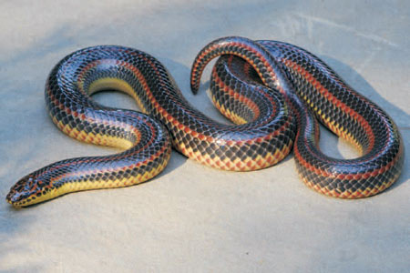
Order : Squamata (Snake)

Slide 10
2- Order : Chelonia (Turtle)
  Phylum : Chordata
  Subphylum : Vertebrata
  Superclass : Tetrapoda
  Class : reptilia
  Order : Chelonia (Tetudinia)
  Family : Geoemydidae
  Genus : Cleymms
  Species : Cleymms caspica caspica (Mauremys caspica)

Slide 11
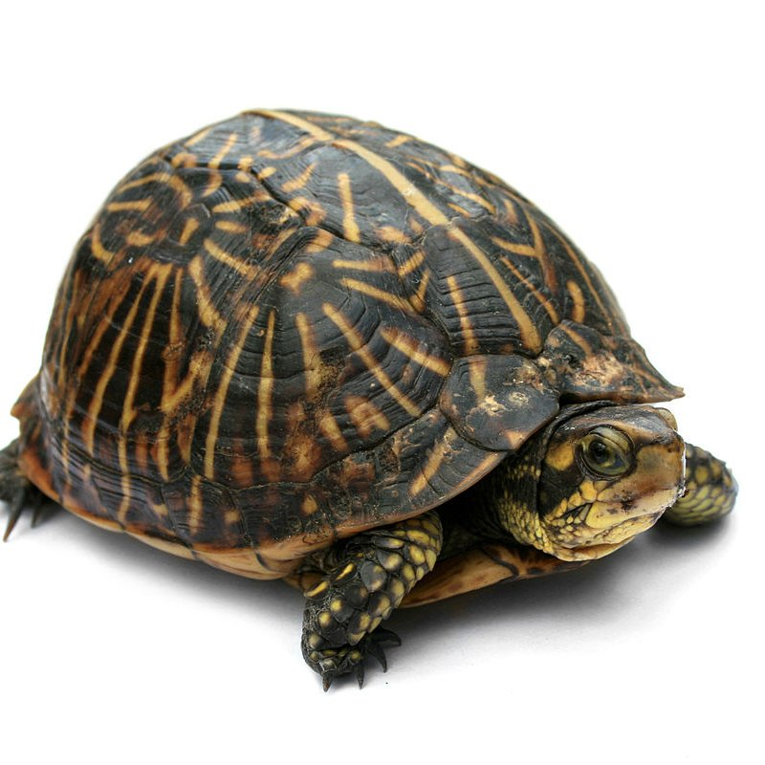
Order : Chelonia (Turtle)

Slide 12
3- Class : Aves
Fusiform body shape, with head, long neck region ,trunk, and tail.
Fore limbs modified for flying, and hind limbs modified for running, swimming, and perchingالجثوم على اغصان الاشجار .
Body cover by feathersالريش .
Sexes are separated and fertilization is internal. Male has no copulatory organاعضاء جماع , with the exception of duckبط geese وز and ostrichesنعام .
Order : Columbiforms (Pigeon)

Slide 13
Order : Columbiforms (Pigeon)
  Phylum : Chordata
  Subphylum : Vetebrata
  Superclass : Tetrapoda
  Class : Aves
  Subclass : Neornithes
  Order : Columbiforms
  Family : Columbidae
  Genus : Columba
  Species : Columba livia domestica

Slide 14
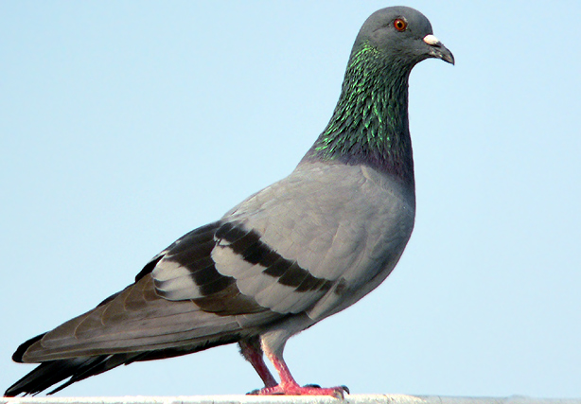
Order : Columbiforms (Pigeon)

Slide 15
4- Class : Mammalia
Body cover by hair.
The integument rich with glands (sebaceous glandsغدد دهنيه , sweat glandsغدد عرقيه , and mammary glandsغدد لبنيه ).
Have external ears or pinnaeصيوان الاذن الخارجيه .
Sexes are separated, fertilization is internal, males have external copulatory organs
  Order : Lagomorpha (Rabbit)

Slide 16
Order : Lagomorpha (Rabbit)
  Phylum : Chordata
  Subphylum : Vertebrata
  Superclass : Tetrapoda
  Class : Mammalia
  Superorder : Tetrapoda
  Order : Lagomorpha
  Family :Leporidae
  Genus : Oryctolagus
  Species : Oryctolagus cuniculus

Slide 17
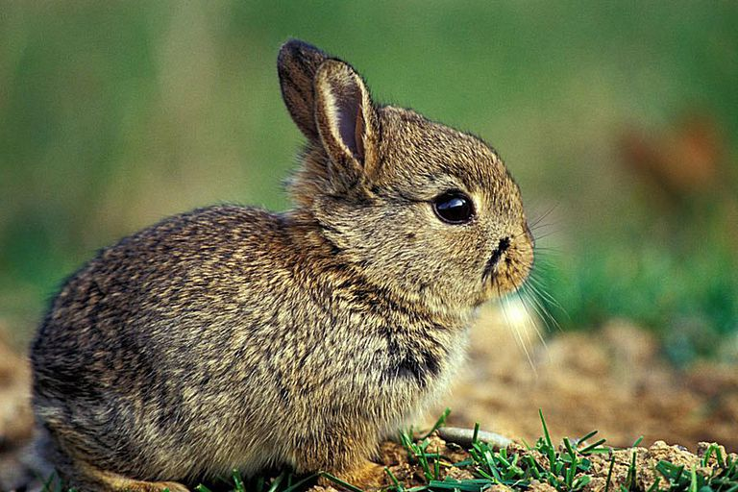
Order : Lagomorpha (Rabbit)

