Slide 1
Biology 4th Stage
Comparative Anatomy laboratory No. 3
Edit by Dr. hind mahmood jumaah

Slide 2
Skeletal System
Discerption, site and function

Slide 3
Skeletal System
What is skeleton?
Skeleton is the hardened tissues of the body together form the skeleton System (sclera,=hard).
Organism will remain small and slow moving if there had been no skeleton for support and to serve as levers on which muscles can act

Slide 4
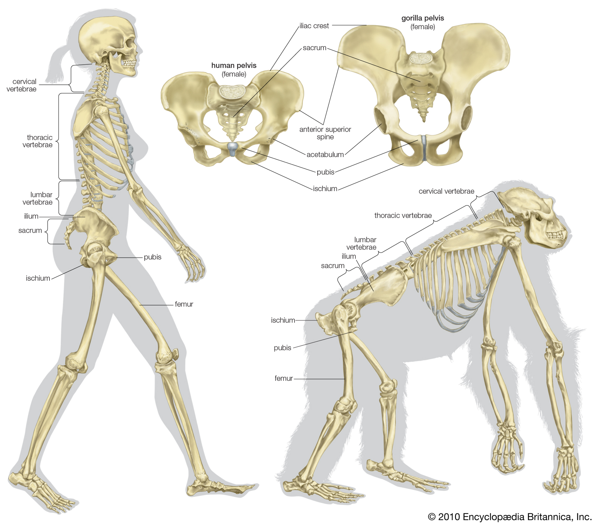
Skeletal System

Slide 5
Skeletal System
What are the types of vertebrates skeleton?
1. Epidermal horny exoskeletonهيكل خارجي متقرن بشري
2. Dermal bony skeletonالهيكل العظمي الادمي
3. Endoskeletonالهيكل الداخلي

Slide 6
1. Epidermal horny exoskeleton
Include hard and horny or keratinized derivatives of the epidermal layer of skin, such as clawsمخالب , reptilian scalesحراشف الزواحف , bird feathersريش الطيور and mammalian hairشعر , hornsقرون , nailsاظافر , hoofsحوافر,…etc..

Slide 7
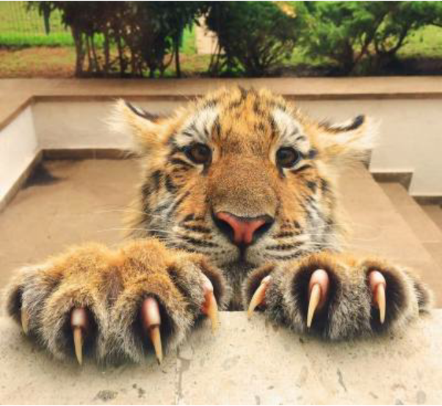
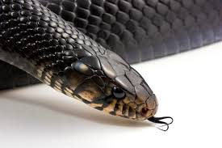
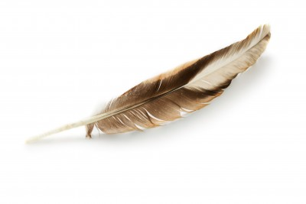
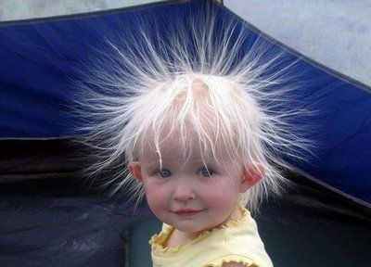
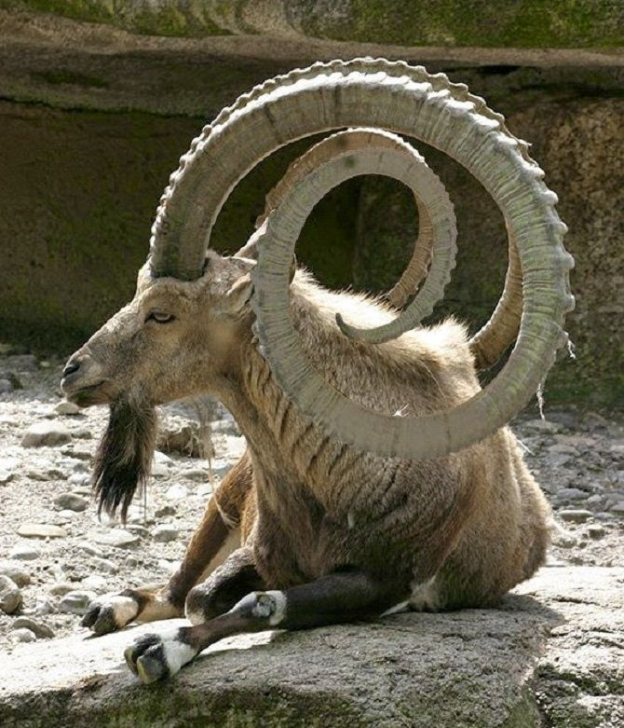
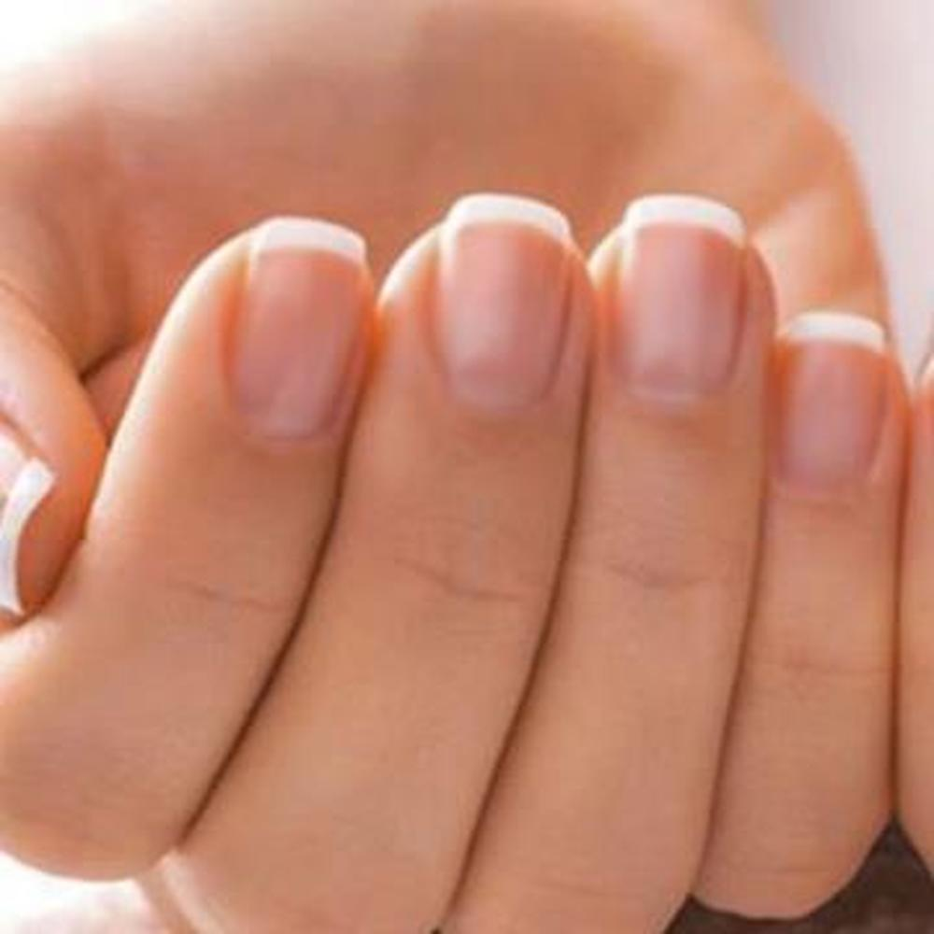
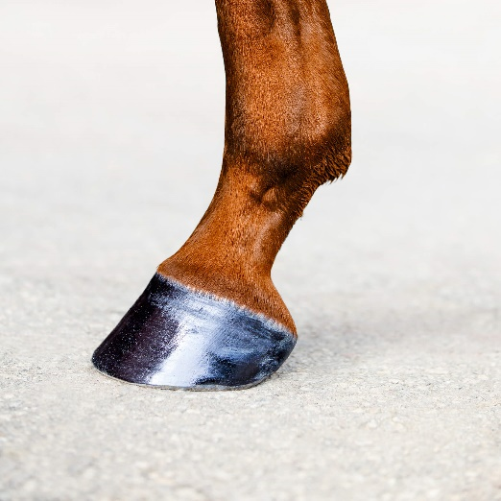
Epidermal horny exoskeleton examples

Slide 8
2. Dermal bony skeleton
Dermal bony skeleton is derived from the dermis of skin, it includes bony scales and plates or scutesتروس او دروع , fin raysالاشعه الزعنفيه and antlers of fish, reptiles and mammals.

Slide 9
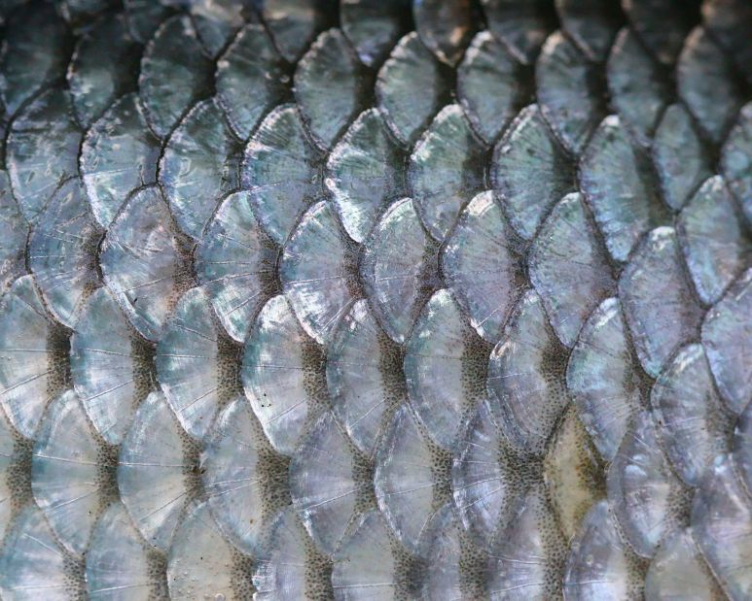
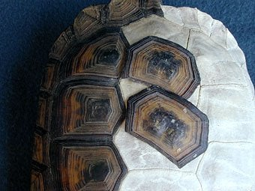
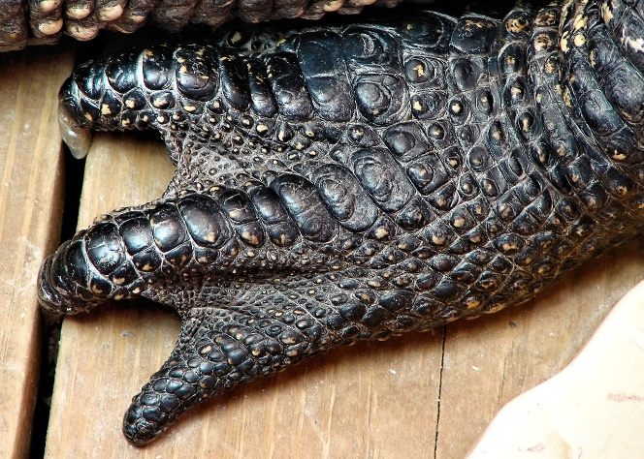
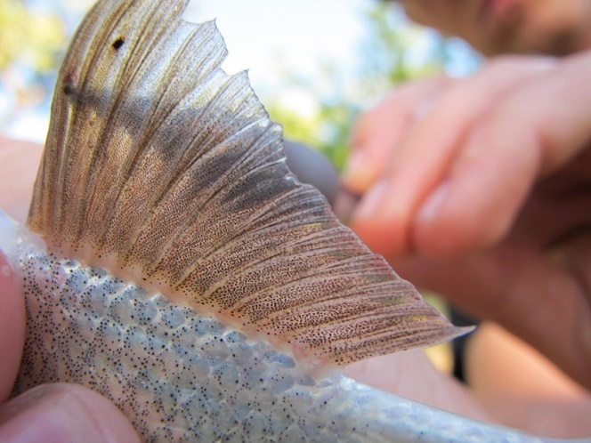
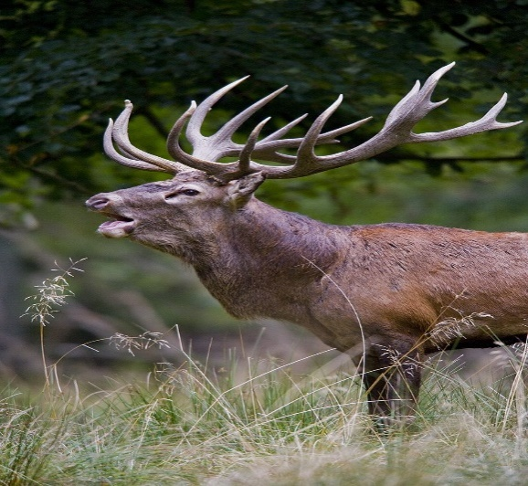
2. Dermal bony skeleton

Slide 10
3. Endoskeleton
Greater part of vertebrate skeleton lies more deeply, forming the endoskeleton.
Functions of endoskeleton:
1. Provide physical support to body by forming a firm and riding internal framework.
2. Give definite body shape and form.
3. Protect by surrounding delicate internal organs such as brain, heart, lungs,--etc.
4. Permit growth of huge body size.
5. Provide surface for attachment of muscles.
6. Aid in hearing (ear ossiclesعظيمات الاذن ).
7. Manufacture blood corpuscles in bone marrow.
8. Help in breathing (tracheal ringsحلقات الرغامى , ribsالاضلاع ).

Slide 11
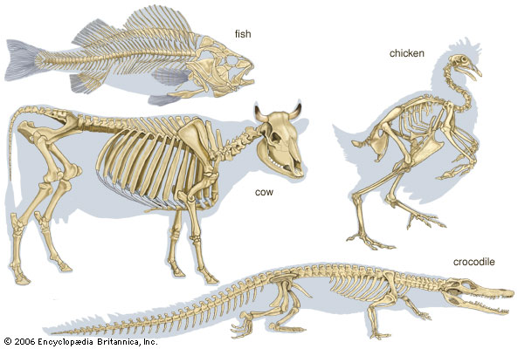
3. Endoskeleton

Slide 12
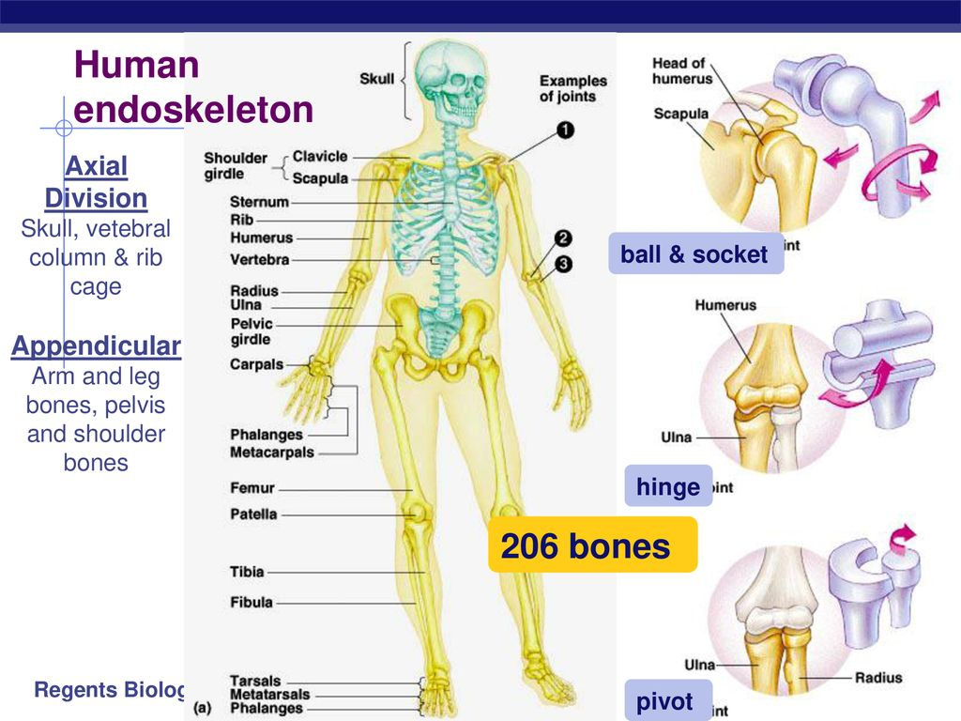
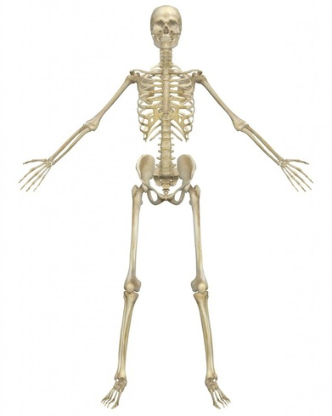
3. Endoskeleton

Slide 13
subdivision of vertebrates endoskeleton
1. Somatic skeletonالهيكل الجسمي
  a. Axial skeletonالهيكل المحوري which include skullالجمجمه ,vertebral columnالعمود الفقري , ribs, and sternumالقص .
  b. Appendicular skeletonالهيكل الطرفي which include girdles and limbs.
2. Visceral skeletonالهيكل الحشوي which represents the pharyngeal wall.

