Slide 1
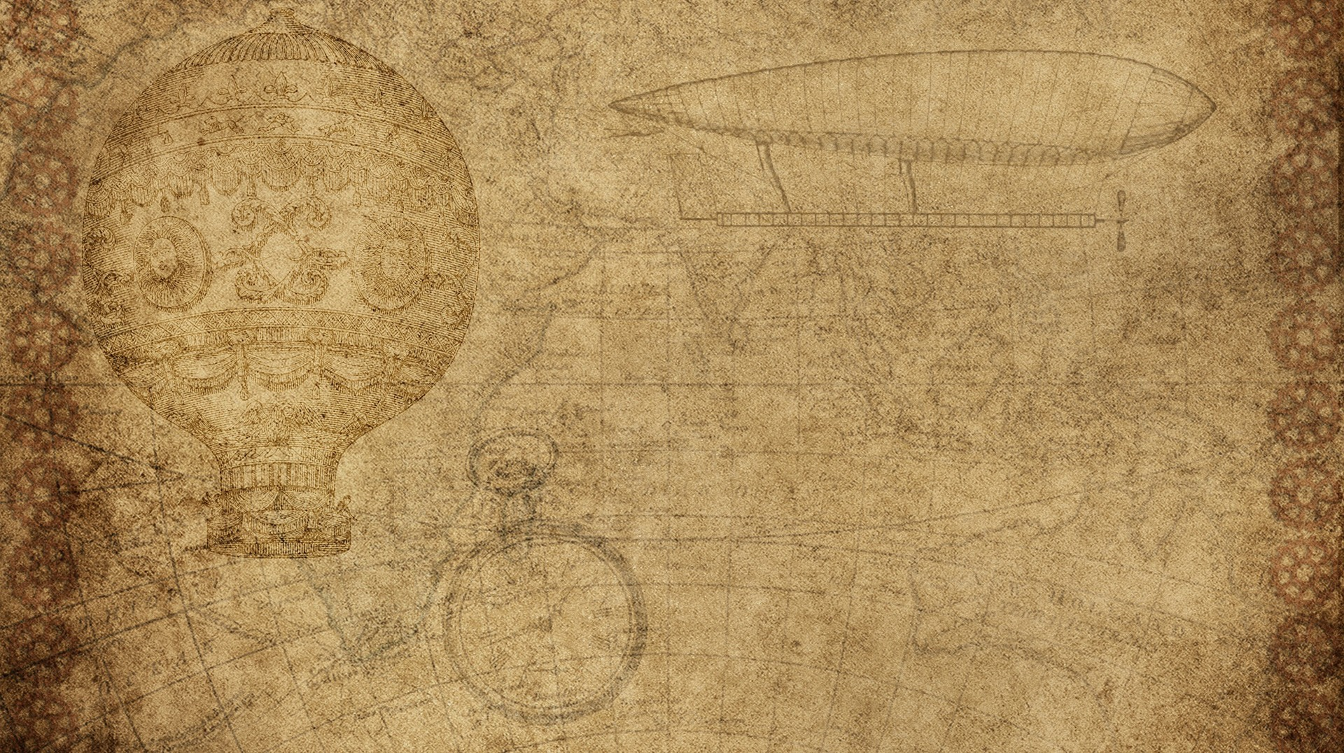

Biology 4th Stage
Comparative Anatomy lab No. 5
Edit by Dr. hind mahmood jumaah

Slide 2
COMPARATIVE ANATOMY OF VERTEBRATES Skulls
Edit by Mohammed Sabbar

Slide 3
1. Cyclostomata (Lamprey)
Skull is composed several cartilaginous plates represented by the following:
  Anterior dorsal cartilage الغضروف الظهري الامامي.
  Posterior dorsal cartilageالغضروف الظهري الخلفي .
  Posterior lateral cartilageالغضروف الجانبي الخلفي.
  Olfactory capsuleالعلبه او المحفظه الشميه .
  Otic capsuleالعلبه او المحفظه السمعيه .

Slide 4
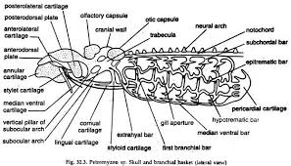
1. Cyclostomata (Lamprey)

Slide 5
2. Cartilagenous fish (dogfish)
Form of skullشكل الجمجمه : elongated and dorso-ventrally flattened.
Skull surfaceسطح الجمجمه : smooth without sutures.
number of bonesعدد عظام الجمجمه : the whole skull is made of cartilage.
foramen magnumالثقب الكبير او الاعظم : posteriorly directed.
interorbital septumالحاجز بين المحجري : absent.
otic bonesالعظام السمعيه : absent.

Slide 6
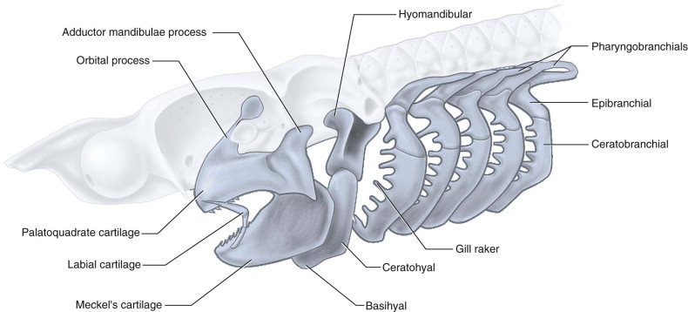
2. Cartilagenous fish (dogfish)

Slide 7
3. Bony fish
form of skull: mostly elongated.
*skull surface: mostly smooth in teleost fish.
*number of bones: high number in comparison with any other vertebrates( reach to more than 180 bones).
*foramen magnum: posteriorly directed.
*inter-orbital septum: present and may be absent in some.
*otic bone: absent.

Slide 8
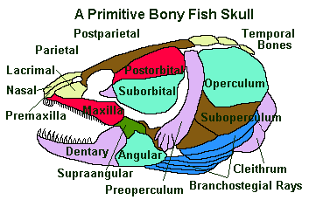
3. Bony fish

Slide 9
4. Amphibia
*form of skull: wide and dorso-ventral flattened.
*skull surface: rough with distinct sutures..
*number of bones: fewer (about 36 bones).
*foramen magnum: posteriorly directed.
*inter-orbital septum: absent.
*otic bones: single bone.

Slide 10
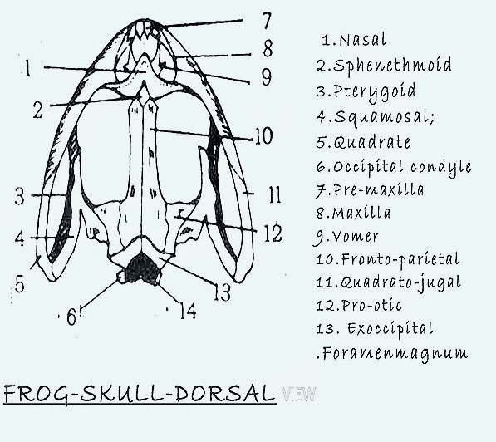
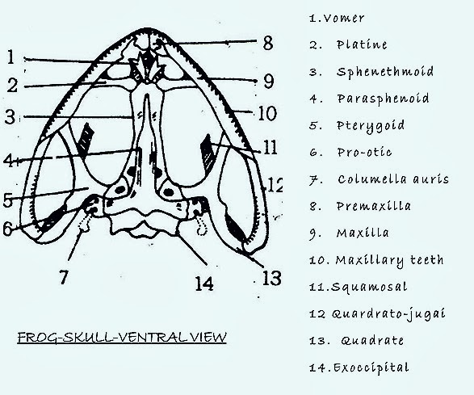
4. Amphibia

Slide 11
COMPARATIVE ANATOMY OF some VERTEBRATES Skulls
 | Cartilagenous fish | Bony fish | Amphibia
Form of skull شكل الجمجمه | elongated and dorso-ventrally flattened | mostly elongated | wide and dorso-ventral flattened
skull surface سطح الجمجمه | smooth without sutures | mostly smooth in teleost fish | rough with distinct sutures
number of bones عدد عظام الجمجمة | the whole skull is made of cartilage | high number in comparison with any other vertebrates( reach to more than 180 bones). | fewer (about 36 bones).
foramen magnum الثقب الكبير او الاعظم | posteriorly directed | posteriorly directed | posteriorly directed
inter-orbital septum الحاجز بين المحجري | absent | present and may be absent in some | absent
otic bones العظام السمعيه | absent | absent | single bone

