Slide 1
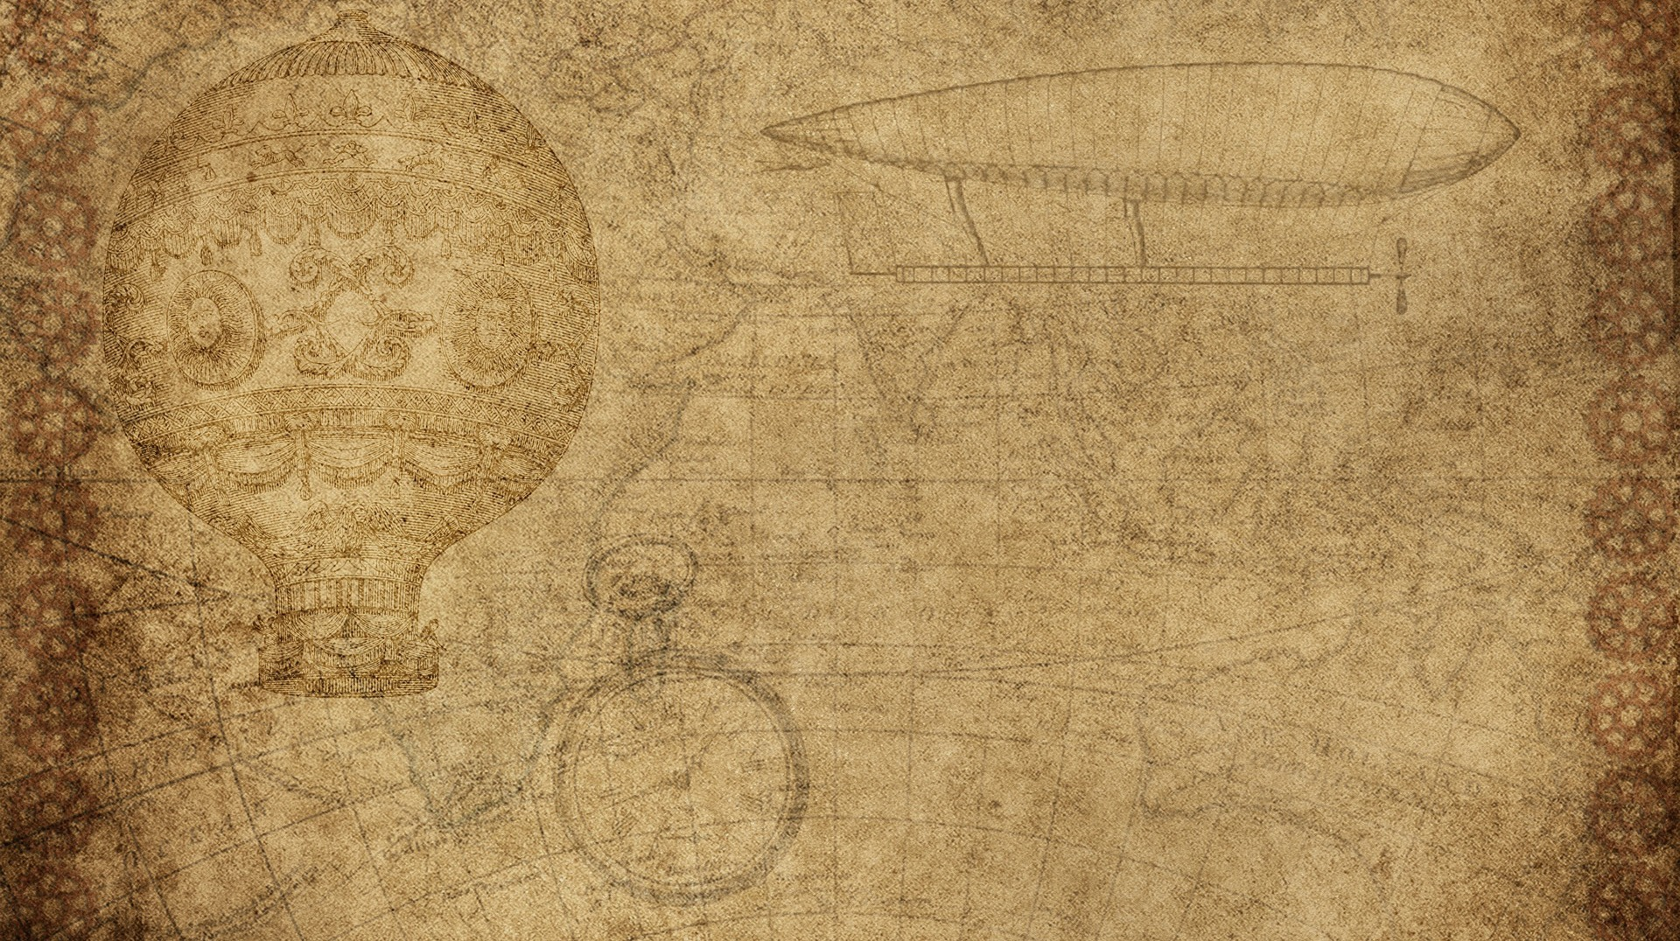

Biology 4th Stage
Comparative Anatomy lab No. 7
Edit by Dr. hind mahmood jumaah

Slide 2
Vertebral column

Slide 3
Notochord
In all chordate embryos, the first axial endoskeleton to appear is un-segmented gelatinous rod, the notochord.
It is present below the nerve cord and above the digestive tract.
Its ancestral predecessor is not known but it probably originated from endoderm.

Slide 4
Notochord
Typically, notochord is covered by inner and outer elastic fibrous connective tissue sheaths called elastic interna and elastic externa, respectively.
In protochordates (amphioxus) and cyclostomata (lamprey) , notochord persists throughout the life and continues grow with the animal. But in fishes and higher types, notochord is later on surrounded by cartilaginous or bony rings, called vertebrae

Slide 5
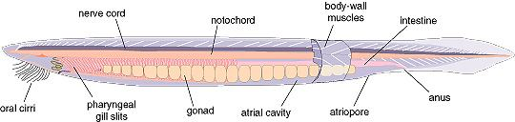
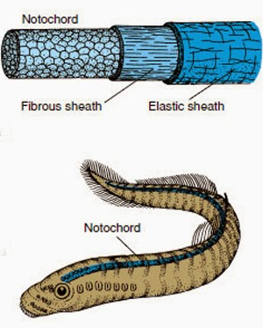
Notochord

Slide 6
Vertebrae
Backbone or vertebral column of all vertebrates is found of metameric series of many small and essentially similar pieces, called vertebrae.
Vertebra is the unit of vertebral column.
Morphologically, vertebrae differ in different vertebrates or even in different regions of the same vertebrate, but all vertebrae are built according to a similar basic pattern.

Slide 7
Basic structure of vertebra
Typically a vertebra has a cylindrical, body or centrum which encloses or replaces the embryonic notochord.
Above the centrum is the neural arch produced dorsally into a neural spine.
Successive neural arches enclose a vertebral or neural canal in which the spinal cord lies.
Each vertebra posses several processes.

Slide 8
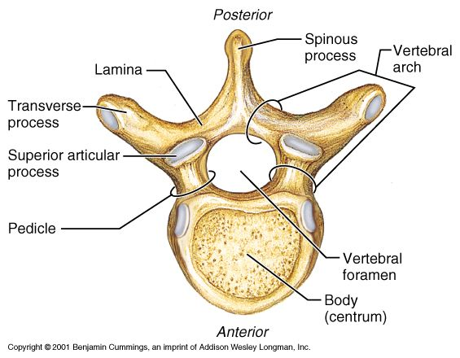
Basic structure of vertebra

Slide 9
Type of vertebrae
Vertebrae classified according to their centrum into :
  1. Procoelousمقعره من الامام محدبه من الخلف
  2. Opisthocoelousخلفية التقعر (مقعره من الخلف محدبه من الامام)
  3. Amphicoelousثنائية التقعر (مقعرة الوجهين)
  4. Acoelous or amphiplatyanعديمة التقعر او مسطحة الوجهين
  5. Heterocoelousالسرجيه او متباينة التقعر
  6. Biconvexمحدبة الوجهين

Slide 10
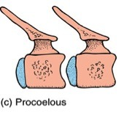
Procoelousمقعره من الامام محدبه من الخلف
Anterior face of centrum is concave and posterior face is convex.
Example: typical vertebrae of frog and most reptiles.

Slide 11
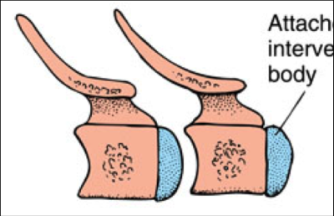
Opisthocoelous خلفية التقعر
(مقعره من الخلف محدبه من الامام)
Centrum is concave posteriorly and convex anteriorly.
Example : Cervical vertebrae of some large ungulatesالفقرات العنقيه في الظلفيات .

Slide 12
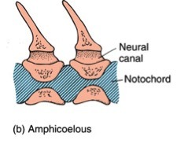
Amphicoelousثنائية التقعر (مقعرة الوجهين)
Centrum is concave at both ends.
Example: Vertebrae of fish and 8th vertebra of frog.

Slide 13
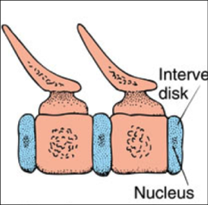
Acoelous or amphiplatyanعديمة التقعر او مسطحة الوجهين
Centrum is flat at both ends.
Example: Vertebrae of mammals.

Slide 14
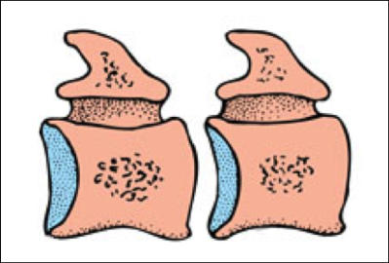
Heterocoelousالسرجيه او متباينة التقعر
Centrum is like a saddleسرج .
Example : Vertebrae of modern birds.

Slide 15
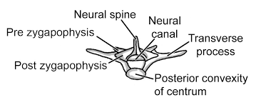
Biconvexمحدبة الوجهين
Centrum is biconvex at both ends.
Example : Sacral vertebra of frogالفقره العجزيه في الضفدع .

Slide 16
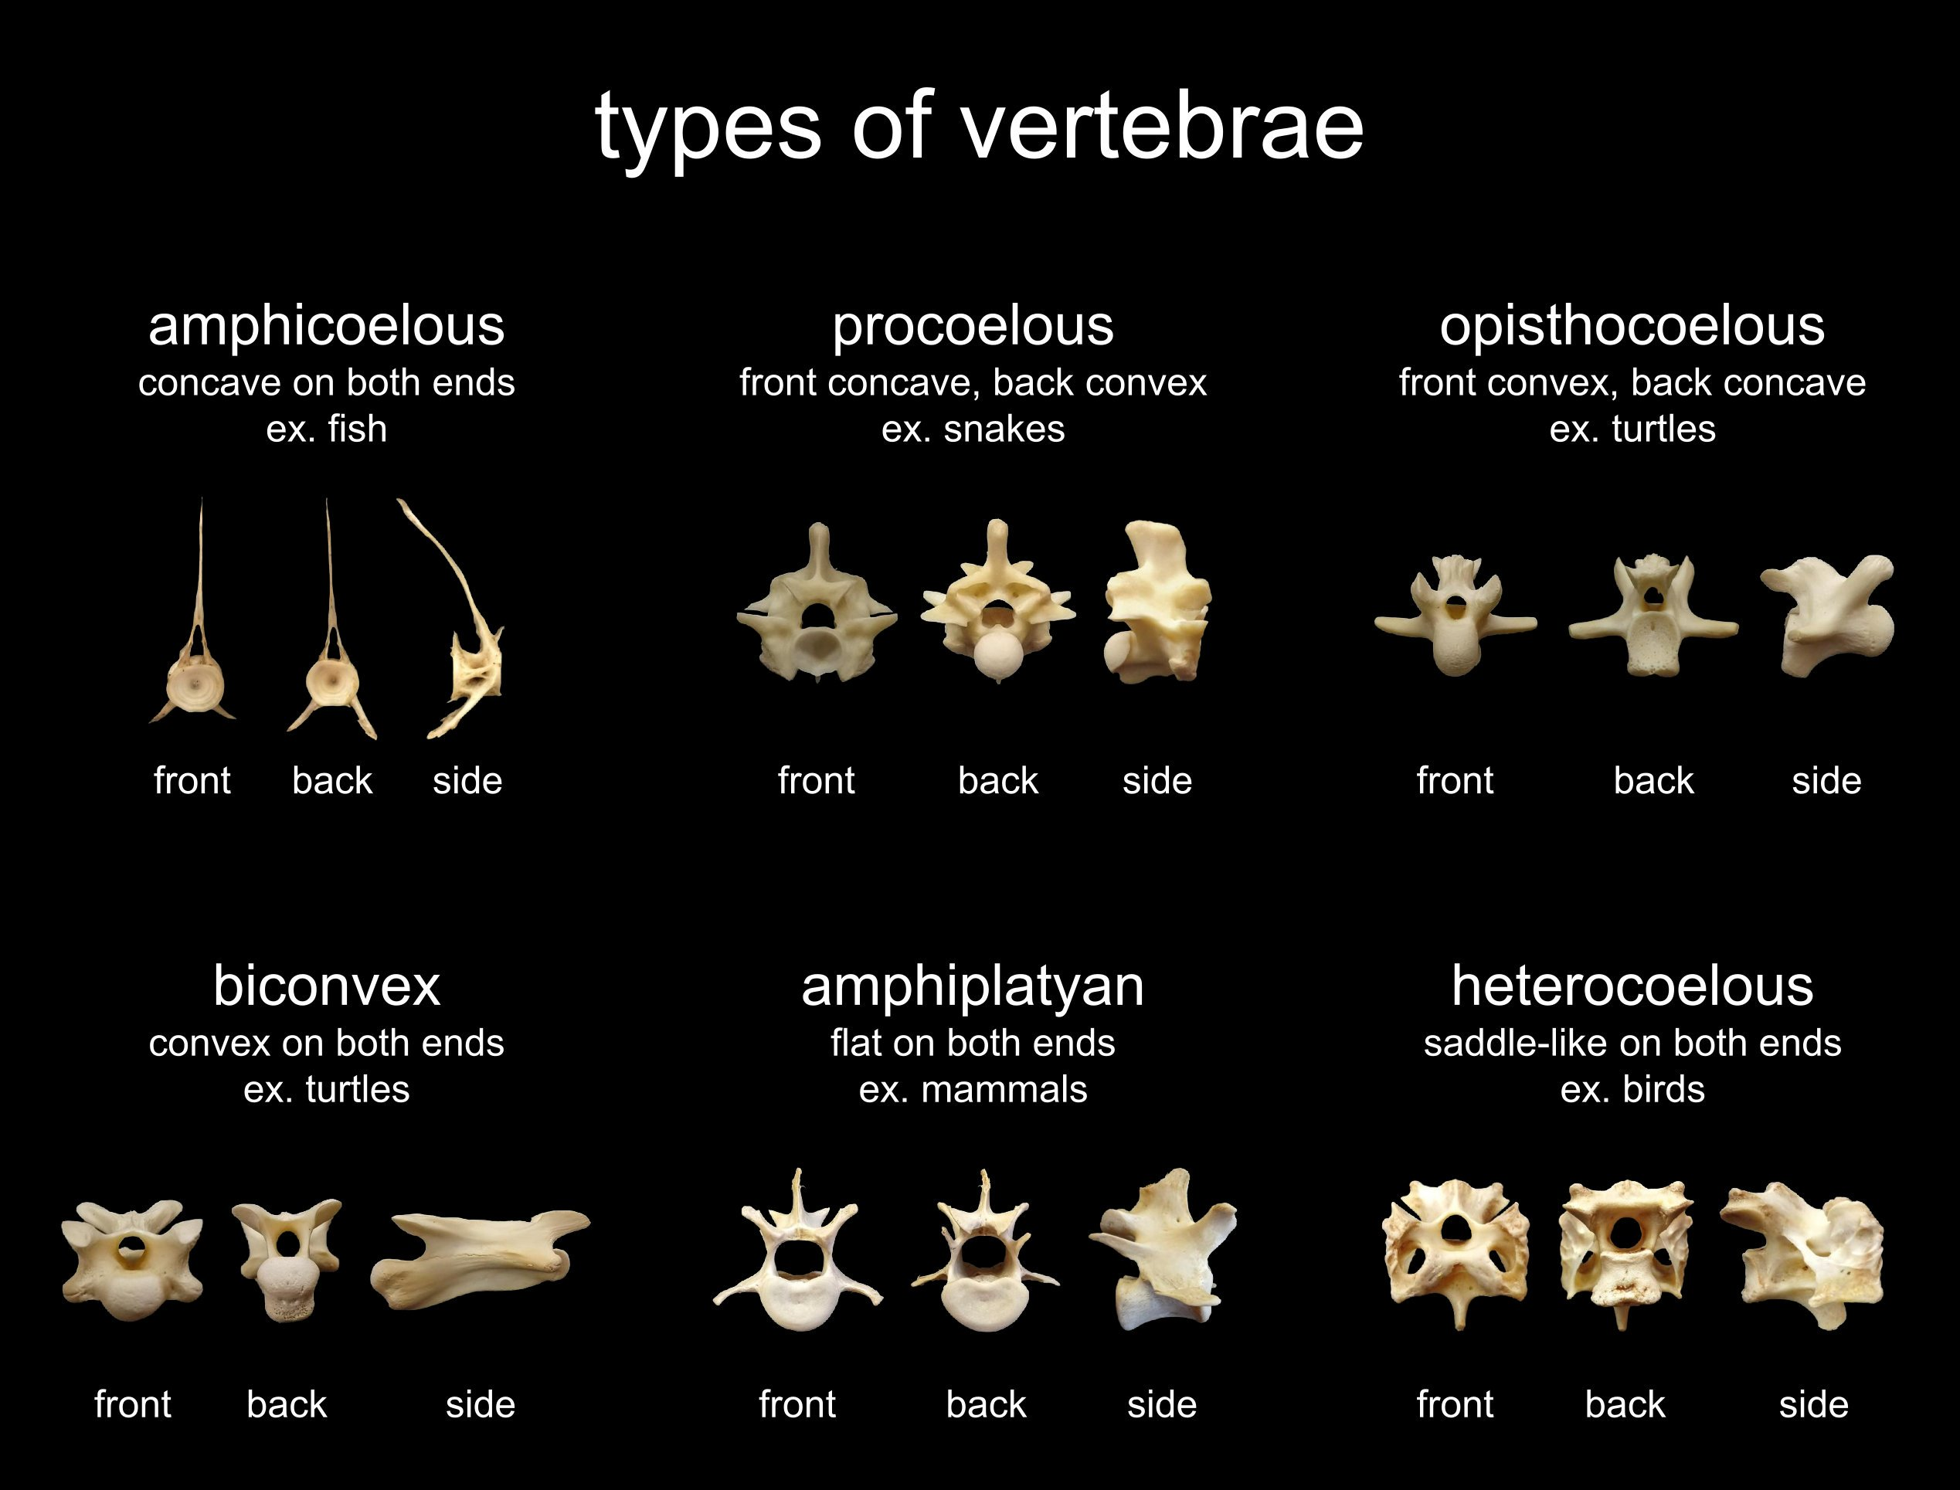
types of vertebrae

