Slide 1
Biology 4th Stage Comparative Anatomy lab No. 8
Edit by Dr. hind mahmood jumaah

Slide 2
Vertebral column part 2
Edit by Mohammed Sabbar

Slide 3
Vertebral column
1. In Amphioxus and cyclostomata the are represented by notochord.
2. Fish
3. Amphibia

Slide 4
2. Fish
• In dogfish there are two types of vertebrae represented by :
1.Trunk vertebrae.
2.Caudal vertebrae.
* Both types are amphicoelous.
The neural arches of the adjacent vertebrae are fused ( connect with each other) by a cartilaginous plates called intercalated disc.

Slide 5
2. Fish

Slide 6
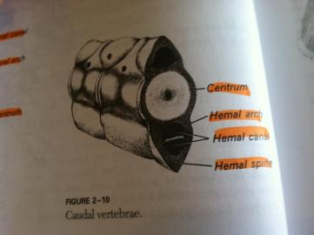
2. Fish
• Trunk vertebrae possess two small transvers processes attached with each a ventral rib.
• In Caudal vertebra the ribs are fused together to form the haemal arch with a haemal canal to pass the caudal artery and vein.
• In bony fish there is no intercalated disc between the neural arch of the adjacent vertebrae.

Slide 7
2. Fish

Slide 8
3. Amphibia
Vertebral column in frog lies mid-dorsally in body.
It encloses and protect the spinal cord.
Vertebral column of frog is exceptionally short in the absence of a tail.
Atlas vertebra (1st vertebra) is in the form of a very small bony ring with reduced centrum and neural spine and without transvers processes and prezygapophysis.
The 2nd vertebra is typical in structure with slight variation.
Typical vertebra has a ring like form with a large hole, called neural canal, through which the spinal cord passes. The ventral thick and solid rod-like part of the ring is centrum or body.

Slide 9
3. Amphibia
Dorsal arch of the ring is called neural arch.
The vertebrae 3-8 are all represented typical vertebrae.
The 9th vertebra is sacral vertebra which is differ s in many respect from the typical structure ( its centrum is biconvex, bearing one anterior convexity, fitting into the posterior concavity of 8th vertebrae, and two posterior convexities fitting into the anterior concavities of urostyle).
Urostyle is unsegmented part of vertebral column which is as long as the rest of vertebral column. It is somewhat triangular in out line with the pointed apex directed backward.

