Slide 1
Biology 4th Stage Comparative Anatomy lab No. 9
Edit by Dr. hind mahmood jumaah

Slide 2
Vertebral column part 3
Edit by Mohammed Sabbar

Slide 3
Vertebral column
Reptilian
Birds
Mammalia

Slide 4
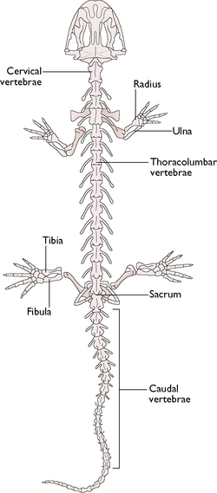
5. Reptilia
Vertebral column differentiated into :
1. Cervical region.منطقه عنقيه
2. Thoraco-lumbar region.منطقه صدريه قطنيه
3. Sacral region.منطقه عجزيه
4. Caudal region.منطقه ذيليه

Slide 5
5. Reptilia
The cervical region consist of Atlas (the first vertebra), Axis المحور (the second vertebra), and different number of cervical vertebrae differ in different species of reptiles, the vertebrae are procoelousامامية التقعر . .
The thoraco-lumbar vertebrae are larger than the cervical vertebrae. They are procoelous.
The sacral vertebrae are two vertebrae fused together, the centrum is procoelous, the neural spine is short, with well developed transvers process.
The caudal vertebrae are numerous and they are become smaller toward the posterior end.

Slide 6
6. Birds
---- Vertebral column divided into :
1. Cervical region.منطقه عنقيه
2. Thoracic region.منطقه صدريه
3. Sacral region.منطقه عجزيه
4. Caudal region.منطقه ذيليه

Slide 7
6. Birds
Cervical vertebrae are 8-25 in number, they are heterocoelousفقره سرجيه .
Atlas vertebra is small and annular ,has no centrum, neural spine, transvers processes, and prezygapophysisنتوء نيري امامي .
The typical cervical vertebrae are long heterocoelous with vestigial neural spineشوكه عصبيه .
Thoracic vertebrae are fused , they are with heterocoelous centrum, and fused neural arches and transvers processes.
In the sacral region there is special structure formed from 14-16 vertebrae This structure is called Synsacrum, which support the ilium bone of pelvic girdle.
The caudal vertebrae are either to be free or fused ,the pygostyle is formed from 4 or more caudal vertebrae.

Slide 8
7. Mammalia
The vertebral column in rabbit consists 5 regions:
Cervical regionمنطقه العنقيه .
Thoracic regionمنطقه الصدريه .
Lumbar regionمنطقه القطنية .
Sacral region منطقه العجزية.
Caudal region منطقة الذيلية.

Slide 9
7. Mammalia
---- The cervical vertebrae of rabbit are 7 in number
---- The first cervical vertebra is atlas posses a large neural arch and reduced neural spine and centrum.
---- The typical cervical vertebrae are differentiate by the amphiplatyan centrum and large neural canal.
---- The thoracic vertebrae are 12-13 vertebrae, they are with well developed neural arch, neural spine and prezygapophysis and postzygapophysis.
---- The lumbar vertebrae are 6-7 each has a large centrum, neural arch and neural canal.
---- Sacral vertebrae are fused with each other.
---- The caudal vertebrae in rabbit are 16 in number, the only anterior with neural spine.

