Slide 1
Aromatic waters
Aromatic waters provide a pleasantly flavored medium for the administration of water-soluble drugs and for the liquid phase of emulsion and suspensions.
Aromatic water are not therapeutically potent because of the very small proportion of active ingredient present in them.

Slide 2
Aromatic waters
examples:
Aromatic waters prepared from essential oils e.g. peppermint water, have been used as carminative and as vehicle.
Chloroform water: was used in expectorant preparations (dose 5-15ml).
Several aromatic waters are not used as vehicles for oral medication. These include: Rose water, Hamamelis water and camphor water.
Rose water used as perfume,
Hamamelis water or witch Hazel, is employed commonly as a rub and also is used as an astringent and perfume in aftershave lotion and other cosmetic products.
Camphor water is frequently prescribed in eyedrops and eye washes for its slight refreshing effect.

Slide 3
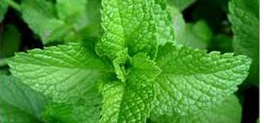
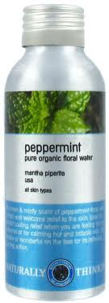
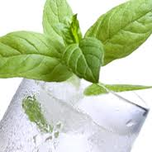
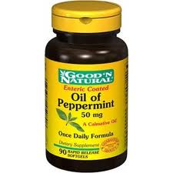
peppermint waters

Slide 4
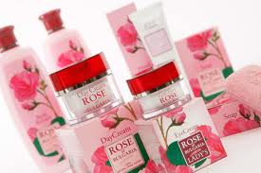
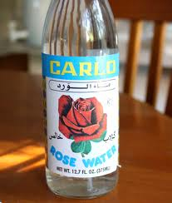
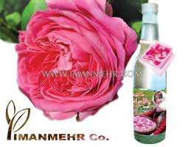
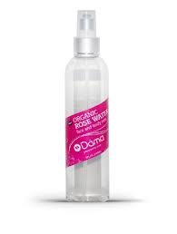
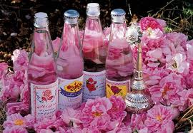
Rose water

Slide 5
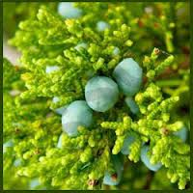
Camphor water
Reduce itching, Rubefacient,
Soothing eye, soothing cough

Slide 6
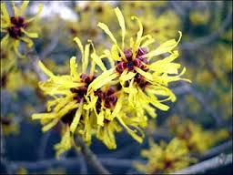
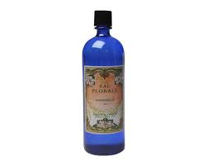
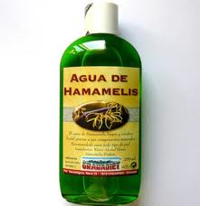
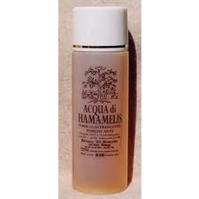
Hamamelis waters

Slide 7
Hamamelis waters
Hamamelis water 12.5% v/v and naphazoline 0.01% w/v Temporary relief of eye redness due to minor eye irritations

Slide 8
Preparation of aromatic waters
1. Distillation: most of aromatic waters can be prepared by distillation. However, it is not practical or economically feasible to use this method in most cases, since other method is of low cost and with simple apparatus required.
Note: aromatic waters which are prepared directly from fresh plant material, e.g. stronger rose water, orange flower water, and Hamamelis water can not be prepared by any method other than distillation.
The distillation method consists of placing the odoriferous portion of the plant in a suitable still with sufficient purified water and then distilling most of the water, carefully. The excess oil is separated from the distillate. The aqueous phase, which may require further clarification is the product.

Slide 9
Preparation of aromatic waters
The product is labeled as X’s, for example XX, XXX . Each X representing one distillation. So XXXX means that four times repeated process.
This process is called re-distillation. This is done or carried on to get a saturated solution if it is not obtained from the 1st distillation.

