Slide 1
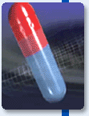
CAPSULES

Slide 2
Text Book
Ansel’s Pharmaceutical Dosage Forms and Drug Delivery Systems
Tenth Edition
Loyd V. Allen, Jr, PhD
Howard C. Ansel, PhD
Section III

Slide 3
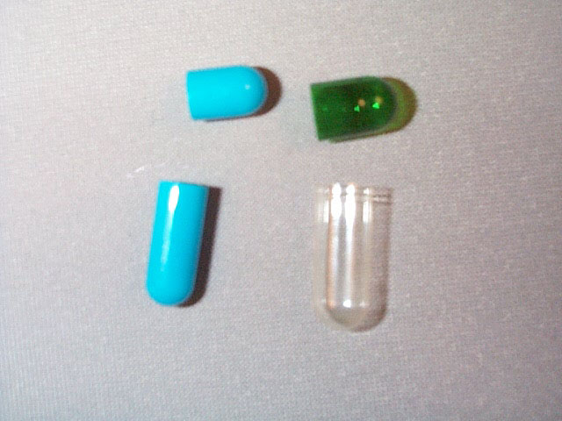
Capsules
Capsules are solid dosage forms in which one or more medicinal and/or inert substances are enclosed within a small shell or container generally prepared from a suitable form of gelatin.
Depending upon their formulation, the gelatin capsule shells may be hard or soft.
Hard Gelatin Capsules

Slide 4
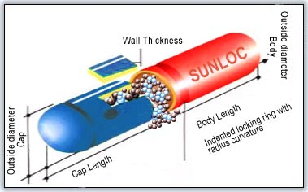

Slide 5
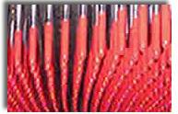
Preparation of hard gelatin capsule shells

Slide 6
Capsule Sizes
Empty gelatin capsules are manufactured in various sizes, varying in length, in diameter, and capacity.
The size selected for use is determined by the amount of fill material to be encapsulated .
5

Slide 7
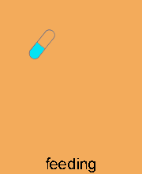
Preparation of Filled Hard Gelatin Capsules

Slide 8
Developing the formulation and selection of capsule size

Slide 9
Developing the formulation and selection of capsule size
Diluents
Wetting agent
Liquids
Eutectic mixtures

Slide 10
Filling the capsule shells
"Punch" Method
Hand-Operated Capsule Filling Machines
Automatic-Operated Capsule Filling Machines

Slide 11
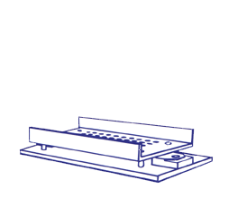

Slide 12
Automatic-Operated Capsule Filling Machines

Slide 13
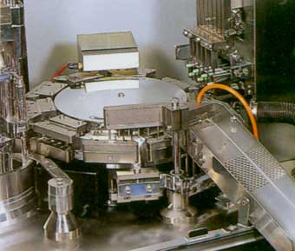

Slide 14
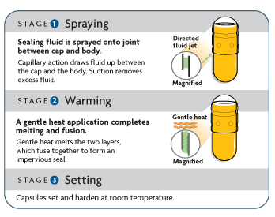
SEALING of Gelatin capsules
Cleaning and polishing the filled capsules

Slide 15
Soft Gelatin Capsules

Slide 16
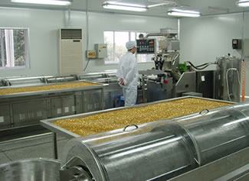
Preparation of Soft Gelatin Capsules
Soft gelatin capsules may be prepared by:
The plate process, using a set of molds to form the capsules.
The die processes (rotary or reciprocating processes)
more efficient and productive processes

Slide 17
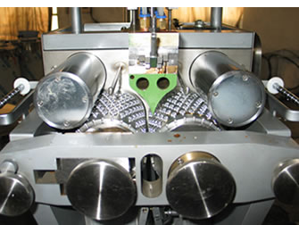
The rotary die process

Slide 18
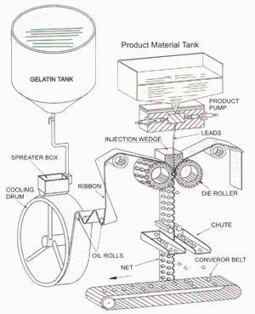

Slide 19
Uses of Soft Gelatin Capsules
1. Water immiscible, volatile and nonvolatile liquids such as vegetable and aromatic oils, aromatic and aliphatic hydrocarbons, chlorinated hydrocarbons, ethers, esters, alcohols, and organic acids.
2. Water miscible, nonvolatile liquids such as polyethylene glycols, and nonionic surface active agents as tween 80.
3. Water miscible and relatively non volatile compounds such as propylen glycol and isopropyl alcohol .

