Slide 1
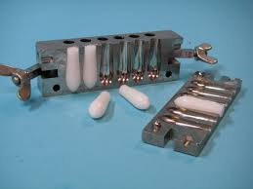
Suppositories part 1

Slide 2
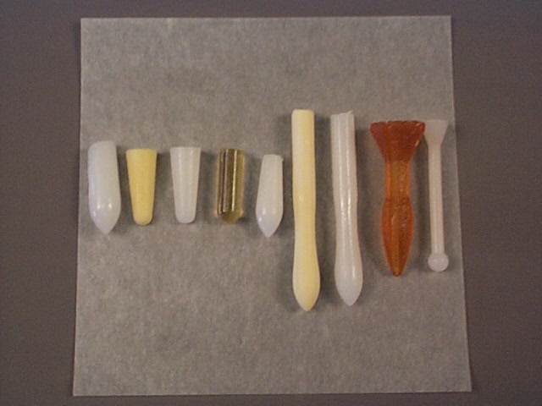
Suppositories
Are solid dosage form intended for insertion into vaginal or rectal cavities where they melt, soften or dissolve and exert localized or systemic effects.
The shape and size of Suppositories must be such that it is capable of being easily insert into the intended body orifice without causing undue distention, and once inserted, it must be retained for appropriate period.

Slide 3
Types of suppository base
A- The fatty bases:
These bases melt at body temperature and consist of the naturally occurring theobroma oil (Cocoa – butter) and synthetic hard fats.
B- Water – soluble and water – miscible bases:
These bases dissolve or disperse in the body fluids. There are two groups of water – soluble bases:
Glycero – gelatin bases.
Macrogol (PEG) bases.

Slide 4
Preparation of Suppository
Suppositories are formulated in different shapes and sizes (usually 1 – 4 g). The suppository consists of a vehicle in which the drug is incorporated and in some cases, additives are co formulated.
Suppositories are manufactured by two general methods:
A- Fusion method (hot process):
The drug is added to the melted base and the mixture allowed cooling after pouring into molds.
B- Compression method (cold process):
The drug is incorporated with the un-melted base and the resulting mass shaped either by hand or by compression force in a metallic mold.

Slide 5
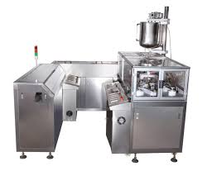
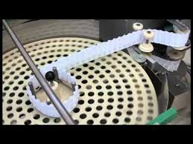
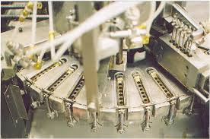
Manufacturing Suppositories

Slide 6
Mold calibration
The mold is generally made of melt in two halves which are clamped together with a screw.
The capacity of the mold is confirmed by filling the mold with the chosen base. The weight of the perfect products is taken and a mean weight calculated. This value is the calibration value of the mold for that particular base.

Slide 7
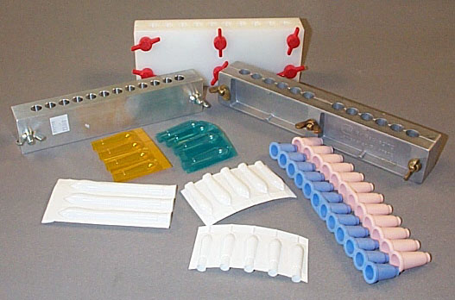
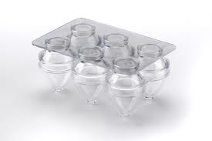
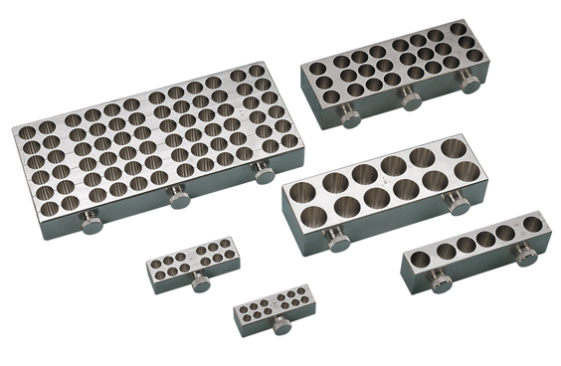
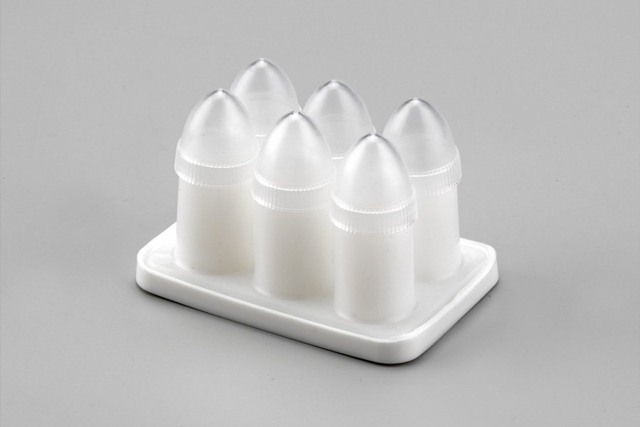

Slide 8
Displacement value (DVs)
The volume of a suppository from a particular mold is uniform but its weight will vary because the density of the medicaments usually differs from the density of the base.
The displacement value of a drug is the number of parts by weight of drug which displaces one part weight of the base

Slide 9
To calculate the DV of a drug:
A batch of unmedicated suppositories is prepared and the products weighed.
A batch of unmedicated suppositories containing a known concentration of the required drug is prepared and the products are weighted.
Wight of six unmedicated suppositories = 6 g
Wight of six unmedicated suppositories containing 40 % drug =8.8 g
Wight of base in this = 60 %
= (600 / 100) ☓ 8 = 5.28 g
Weight of drug in suppositories = 40 %
= (40 / 100) ☓ 8.8 = 3.52 g
Weight of base displaced by drug = 6 – 5.28 = 0.72 g
If the 0.72 g of drug is displaced by 3.52 of base, then 1 g of base will be displaced by 3.52 / 0.72 = 4.88 g
Therefore, displacement value of drug = 4.9

Slide 10
Rx
Bismuth subgallate 300
Cocoa butter q.s
Ft. supp.
Mitt. 6 supp. Using 1g mold
Calculations:
To allow for unavoidable wastage calculate for eight suppositories.
DV of bismuth subgallate = 2.7
bismuth subgallate = 8 ☓ 300 mg = 2.4
2.4 g /2.7 = 0.89 g displaced base
The weight of base required to prepare eight unmedicated suppositories
8 ☓ 1g = 8 g
Therefore, weight of base required for medicated suppositories
8 – 0.89 =7.21

Slide 11
Thank You

