Slide 1
Dissolution of Tablets
Fourth Stage (Practical Lab 5)(

Slide 2
Dissolution: is a process by which a solid goes into solution, the absorption process from G.I.T. happens when the drug in a solution form, so the dissolution is the rate limiting step in the absorption.

Slide 3
Tablets or capsules taken orally remain one of the most effective means of treatment available.
The effectiveness of such dosage forms relies on the drug dissolving in the fluids of the gastrointestinal tract prior to absorption into the systemic circulation. The rate of dissolution of the tablet or capsule is therefore important.

Slide 4
One of the problems facing the pharmaceutical industry is to optimize the amount of drug available to the body, i.e. its bioavailability.
Lacks in bioavailability can mean that the treatment is ineffective and at worst potentially dangerous (toxic overdose).

Slide 5
Drug release in the human body can be measured in-vivo by measuring the plasma or urine concentrations in the subject concerned.
However, there are certain difficulties that led to the introduction of official in-vitro tests which are now defined in the respective Pharmacopoeia.

Slide 6
-Dissolution process affected by a number of factors, such as temperature, stirring rate, solubility of the substances itself & surface area, these factors summarized in Noyes-Whitney equation:-
dc/dt = Ks (Cs-Ct)

Slide 7
𝑑𝑐/𝑑𝑡 = rate of dissolution.
K = dissolution rate constant.
S = surface area of the particle.
Cs = concentration of the drug in the bulk.
Ct =concentration of the drug at time (t)

Slide 8
Dissolution Apparatus:
1- Apparatus I (Basket Apparatus):
The apparatus consists of a metallic drive shaft connected to the cylindrical basket. The basket is positioned inside a vessel made of glass or other inert, transparent material. The temperature of the media inside the vessel is kept constant by a water bath or heating jacket. The solution in the vessel is stirred smoothly by the rotating stirring element.

Slide 9
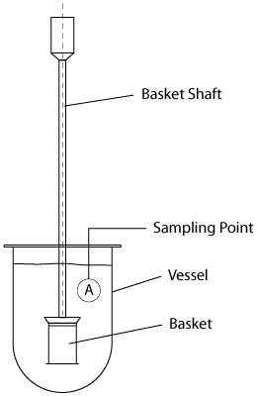

Slide 10
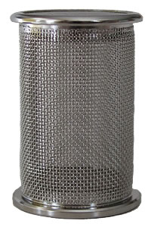
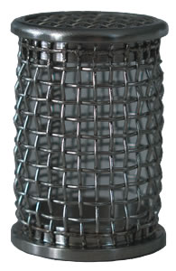
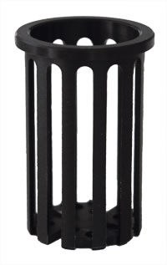

Slide 11
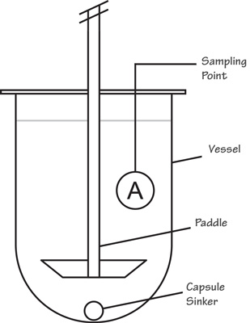
2- Apparatus II (Paddle Apparatus):

Slide 12
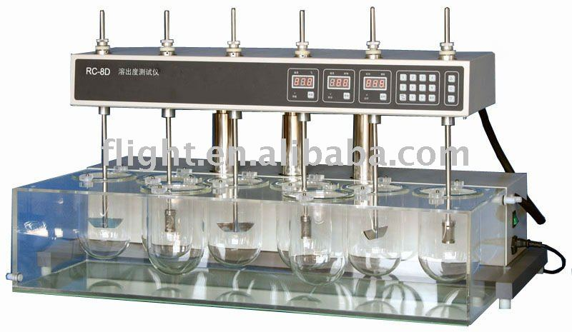

Slide 13
The drug used for the experiment is nitrofuradantin which is weak acidic drug & has low solubility in water, it is absorbed from the stomach, so we will use artificial gastric juice in the study.

Slide 14
Method:-
1- Fill the flask with 500 ml of artificial gastric juice.
2- Switch water bath on until the test fluids are heated to 37 0C.
3- Put (1) tablet of nitrofuradantin (50mg) into a basket and turned the instrument immediately on at a speed of 50 r.p.m.
4- Withdraw 5ml after 5, 10, 15, 20, 30, 40 &50 min. from the surface of the test solution. Stop the apparatus for withdrawal of substance, substitute the volume each time interval with a fresh gastric juice.
5- Start the instrument again.
6- Analyzed the sample of nitrofuradantin by reading the absorption in a spectrophotometry apparatus at 369nm.

Slide 15
Then, use the following equation to obtain the conc. Of nitrofuradantin in mg/100ml.
Y=c+bx
Y=0.01+0.75x
7- List your results in the following table:-
8- Draw the following curve to calculate K which is the dissolution rate constant.
Collecting time(min) | Abs. | Xmg/ml= 𝑦−𝑐/𝑏 | Amount realesed(X=conc.x5) | %realeased (X=amountx2)

