Slide 1


3-Percent Concentration
Chemists express concentrations in terms of percent (part per hundred). Percent composition of a solution can be expressed in several ways. Three common methods are:
a) Weight percent (%w/w): Grams of solute per 100 g of solution
For example, hydrochloric acid is sold as a 37% solution which means that reagent contains 37 g of HCl per 100 g of solution.
b) Volume percent (%v/v): Milliliters of solute per 100 mL of solution.

Slide 2

Example, a 10 % aqueous solution of methanol means diluting 10 mL of pure methanol with enough water to give 100 mL.
c) Weight-to-volume (%w/v): Grams of solute per 100 mL of solution.
For example, 5% aqueous sodium chloride refers to a solution prepared by dissolving 5 g of NaCl in sufficient water to give 100 mL of solution.

Slide 3
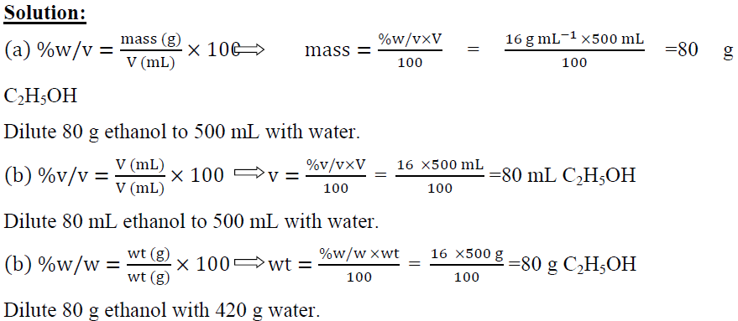
Example 6:-
How would you prepare:
500 mL of 16.0 % (w/v) aqueous ethanol?
500 mL of 16.0 % (v/v) aqueous ethanol?
500 g of 16.0 % (w/w ) aqueous ethanol?

Slide 4

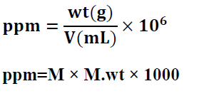

4-Parts per million(ppm) and Parts per billion(ppb)
Parts per million (ppm): Milligrams of solute per liter of solution.

Slide 5
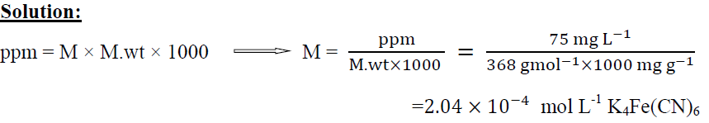

Example 7:-
Calculate the molar concentration of K₄Fe(CN)₆ in a solution that contain 75 ppm of K₄Fe(CN)₆ (M.wt=368 g mol⁻¹).
what are the molar concentration of K⁺ ion in the solution?

Slide 6



Density and the specific gravity
Density (D) is the mass of a substance per unit volume.
Specific gravity (sp.gr) is the ratio of the mass of a substance to the mass of an equal volume of water.
Molarity and Normality of commercial concentrated acids and bases:

Slide 7
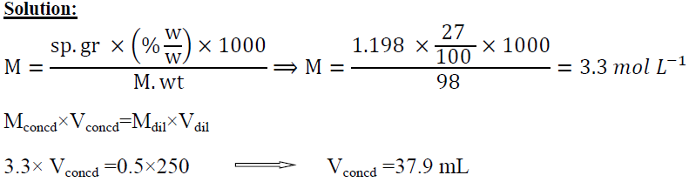
Example 8:-
Calculate the molarity of H₂SO₄ (98 g mol⁻¹) in a solution that has a specific gravity of 1.198 and is 27% H₂SO₄ (%w/w), and describe the preparation of 250 mL of 0.5 M H₂SO₄ solution from concentrated solution of H₂SO₄.

