Slide 1

Smoking cessation products
Nicotine Replacement Therapy (NRT)
Clinical Pharmacist/ Arwa Younis
& Israa Al-Mitwali

Slide 2
Treatment – nicotine replacement therapy (NRT)
Giving up smoking is essentially a matter of self-motivation and determination, and most ex-smokers have stopped without using drugs or any kind of assistance.
Nevertheless, use of nicotine-replacement therapy (NRT) products, which partially replace nicotine from smoking in a regimen that gradually reduces nicotine intake to zero, have been shown to be helpful and are available for people who feel unable to give up smoking unaided.

Slide 3
NRT
Presentations include:
Chewing gum
Transdermal patches
Cigarette-shaped inhaler
Sublingual tablet
Lozenge
Nasal spray

Slide 4
Mode of action
NRT assists smokers to give up by providing nicotine, although at a lower level than is obtained through smoking, in order to prevent withdrawal symptoms and cravings.
After a period at a steady state, nicotine intake is progressively reduced to zero over 2 months.

Slide 5
Chewing gum
Nicotine is absorbed from chewing gum through the buccal mucosa; peak blood concentrations are reached within about 2 minutes, and the contents of a piece of gum are intended to be released over about 30 minutes.
Products available are:
* Nicorette Gum (2 mg, 4 mg)
* Nicotinell Coated Gum (2 mg, 4 mg)

Slide 6
The recommended course of chewing gum is about 3 months, after which the gum is gradually withdrawn over a few weeks.
Professional advice should be sought if there has been no reduction in smoking after 6 weeks or no quit attempt within 9 months.

Slide 7
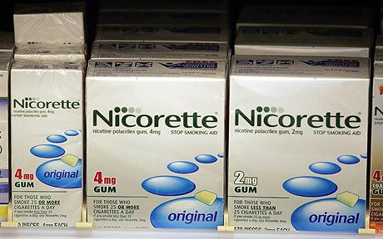
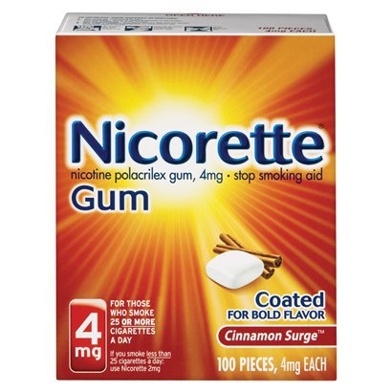
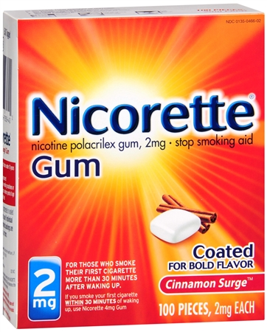

Slide 8
Transdermal patches
There are two types of transdermal patches,both of which are changed daily:
* One is left on for 24 hours.
* One is used for 16 hours daily during waking
hours only and is removed before going to bed.
* The former provides a residual nicotine level the next morning and may be better for smokers who crave a cigarette as soon as they wake up.

Slide 9
With both 16- and 24-hour patches, nicotine plasma concentrations are about half of those obtained from smoking the average number of cigarettes per day.
Products available are:
* Nicorette Patch- 16 hour (5 mg, 10 mg, 15 mg)
* Nicotinell TTS- 24 hour (7 mg, 14 mg, 21 mg

Slide 10
The 24-hour patch is better for smokers who crave a cigarette within 20 minutes of waking up in the morning; otherwise the 16-hour and 24-hour patches are equally suitable and effective.
The 16-hour patch should be used if sleep disturbances occur with the 24-hour patch.

Slide 11
Transdermal patches should be applied daily to a clean, dry, non-hairy area of the trunk or upper arm.
Nicorette patches should be removed at bedtime and a fresh one applied next morning.
To minimize the possibility of localized skin reaction, a new site of application should be chosen each day.
Used patches should be folded in half with the adhesive side inwards and disposed of carefully, because they still contain significant amounts of nicotine, certainly sufficient to poison a child.

Slide 12

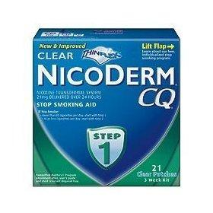

Slide 13
Cautions, contraindications and adverse effects
NRT products provide much lower doses of nicotine than are obtained by smoking.
Because of the cardiovascular effects of nicotine, caution is advised with the use of NRT products in patients with a history of angina, recent myocardial infarction or cerebrovascular accident, cardiac arrhythmias, hypertension or peripheral vascular disease.
Because of the effects of nicotine on metabolism, caution is also advised in patients with diabetes, hyperthyroidism.
With the use of patches, there is a possibility of localized skin reactions; patches should be avoided by patients with any chronic or serious skin condition.

Slide 14
Although nicotine can exacerbate symptoms in patients with peptic ulcers or gastritis, the possibility is greater with gum than with other NRT products, as nicotine may be swallowed and enter the stomach directly.
Patients who wear dentures may have difficulty in chewing gum.
In addition to the potential adverse effects mentioned, NRT products may produce the same range of side-effects as nicotine from smoking. These effects include hiccups, sore throat, headache, nausea and dizziness.
Nicotine withdrawal symptoms such as somnolence, impaired concentration, mood swings, fatigue, hunger, productive cough, bowel disturbances and paraesthesia are also possible.

Slide 15
Interactions
Tobacco smoke reduces serum levels of a wide range of drugs and adjustment of dosage may be necessary when smokers have given up.

Slide 16


